Slide 1

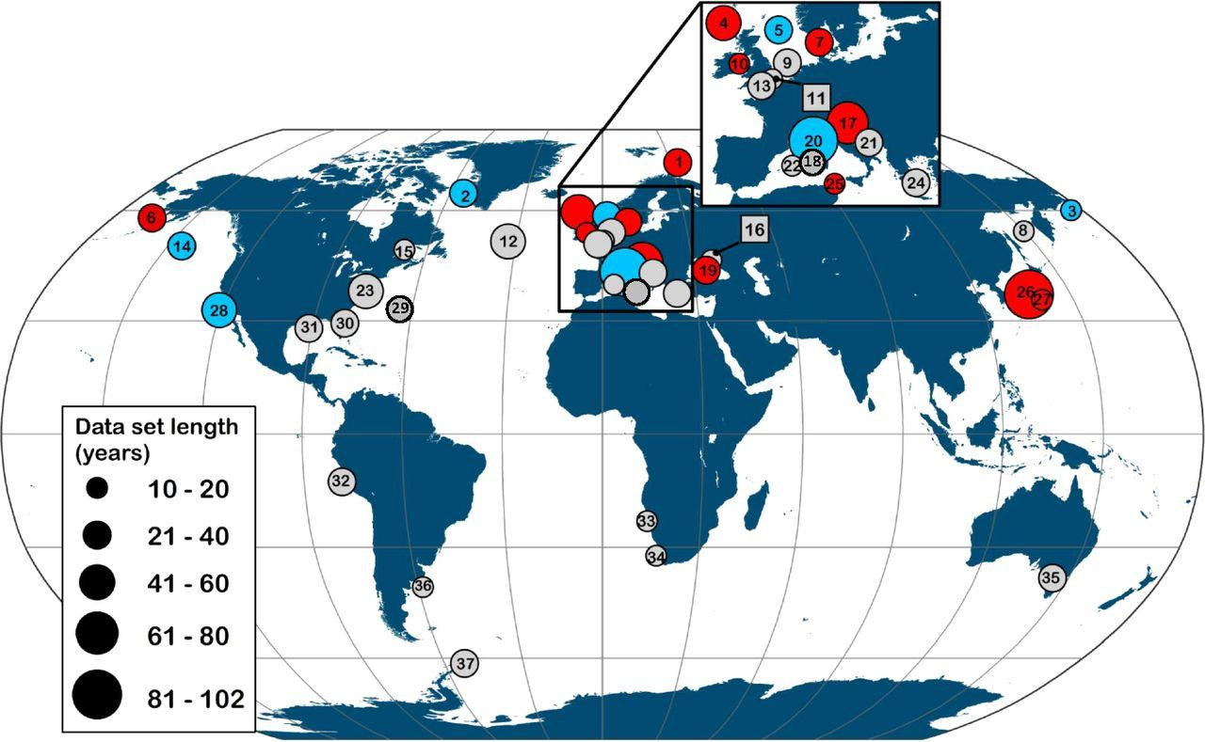

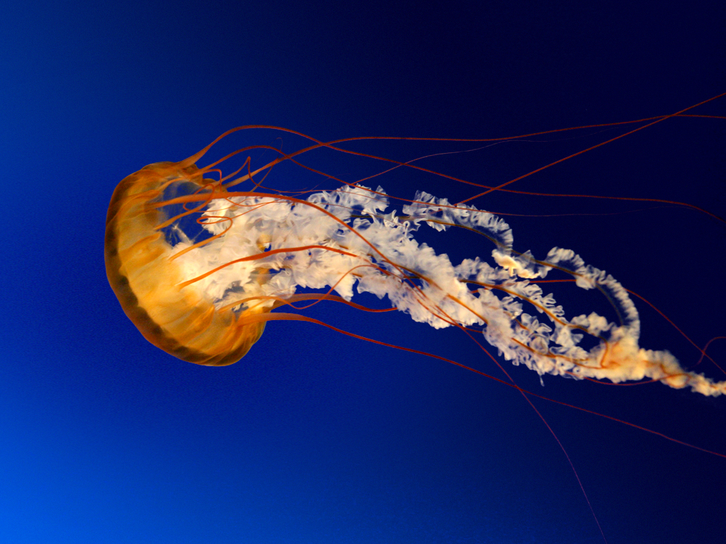

The Title of Your Research Proposal
Your names and Faculty Mentors
RAM Program – Introduction to Research, Farmingdale State College
ABSTRACT
PROPOSED METHOD
This is a summary of your introduction, research question, hypothesis, method, and conclusions.
Describe how you will TEST your hypothesis. Every Method section includes enough detail for the next researcher to perfectly replicate exactly what you did. This section should include:
The Source/Participants - Who or what will provide the data? If people, describe who they are and from where they will be recruited. If archives, describe what these archives are and from where they will be acquired/how they will be accessed. If specimens, describe what they are and from where they will be acquired/how they will be stored.
The Timeline – Is this a one-time experiment? Or will there be a series of experiments over time?
The Procedure – Take the reader through the experiment or process for data collection from start to finish. Describe the variables in your study: Independent Variable (“X” - what you are manipulating) and Dependent Variable (“Y” - what you are measuring to see the impact or effect of the manipulation). How will you measure each variable?
INTRODUCTION
This will include your background information about the topic:
Introduce the problem - Why is this research important? Who or what does the research IMPACT?
Discuss previous research and logically connect these to each other and to your hypothesis
When you make any claims or assumptions, you need to justify or support them with evidence by citing previous research.
ETHICAL CONSIDERATIONS
Ethical Concerns – Discuss any ethical concerns that may result from this study or that were taken into consideration in the design of this study? E.g., How will the data be used? How will it be collected confidentially?
GENERAL IMPACT
RESEARCH QUESTION
Reiterate why this study is important –
Connect it back to your introduction.
What would the results tell us?
How could the results be applied to the real world? What real-world problem would it solve?
State your research question(s) here.
HYPOTHESIS
FUTURE DIRECTIONS
State your hypothesis or hypothesis or hypotheses here.
What are some limitations to your experiment? How might they be resolved with an additional study?
What other types of research may people want to do, now knowing what you have found? Describe what else you would want to know or find out after conducting the research you proposed.
REFERENCES
This is your Word Cited or Bibliography, including all of the previous work you included in your introduction and elsewhere. This is usually presented in APA or MLA format. Check with your department/field of study to see what format they use and use that format.

