Slide 1


Time and Attendance System
UUP Professional Staff & 12 Month Faculty

Slide 2
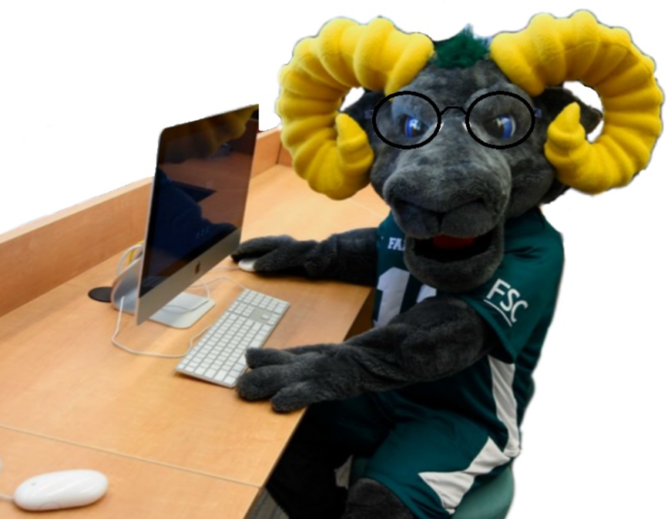
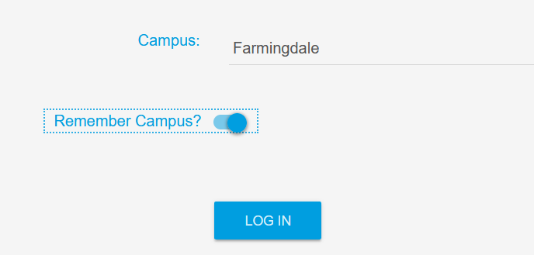
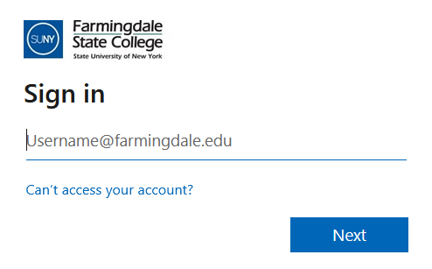


Access
To access the Time & Attendance System (TAS), please use the following link: https://www.suny.edu/time
Please save the login link as a “favorite” for easy access
Login information will be the same as your Farmingdale email credentials.

Slide 3
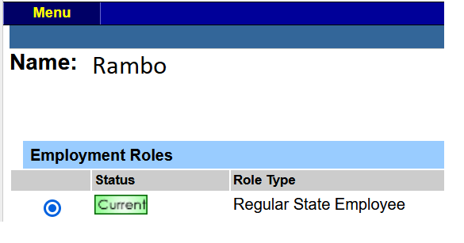

Time Record
Once logged in, select Current under Employment Roles and click on Time and Attendance to open your Time Record.

Slide 4
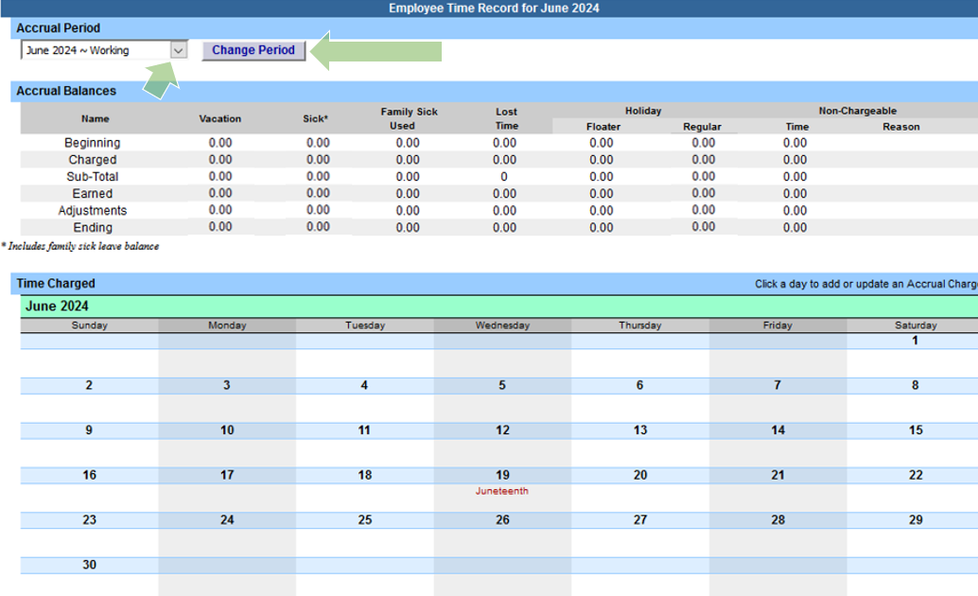
Time Record / Accrual Period
Your first “Working” time record should appear by default.
You may change the Accrual Period (month) by clicking the drop down menu, selecting a month, and clicking Change Period

Slide 5
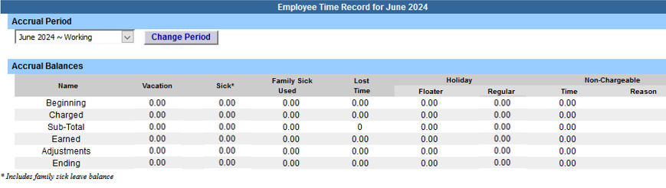
Time Record / Accrual Balances
Beginning = The amount of vacation, sick, and holidays available for use.
Charged = The amount of time being charged.
Sub-Total = The difference between the beginning balance after charged time.
Earned = Accrual earned at the end of the month (Accruals cannot be used in the same month they are earned).
Adjustments = Updates made by HR.
Ending = Beginning balance available at the start of the next month.

Slide 6
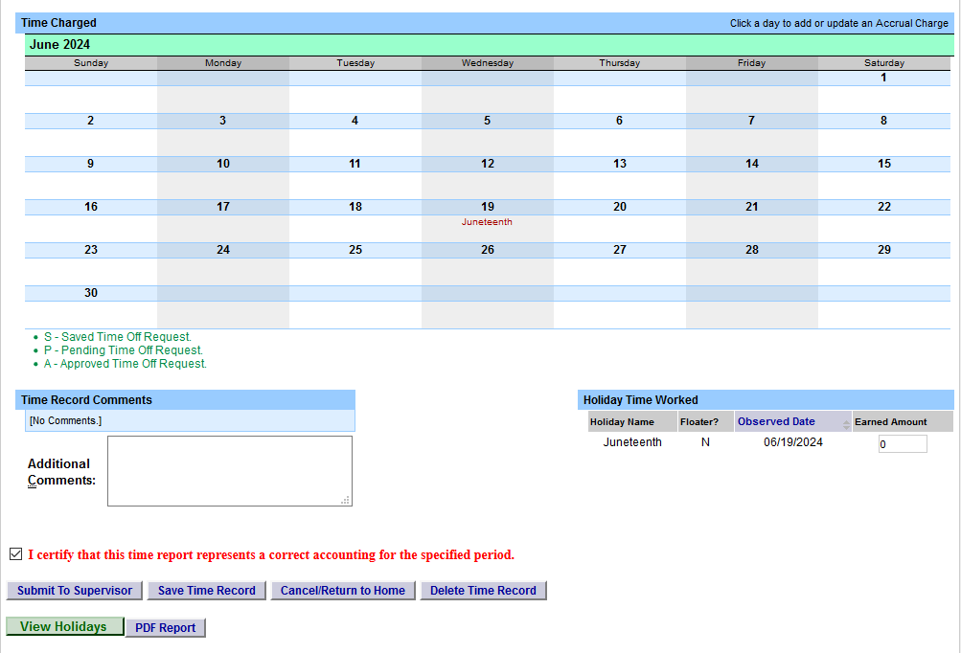
Time Record
Time records are due at the end of each month.
If no time is taken off during the month, certify the blank time record and Submit To Supervisor

Slide 7
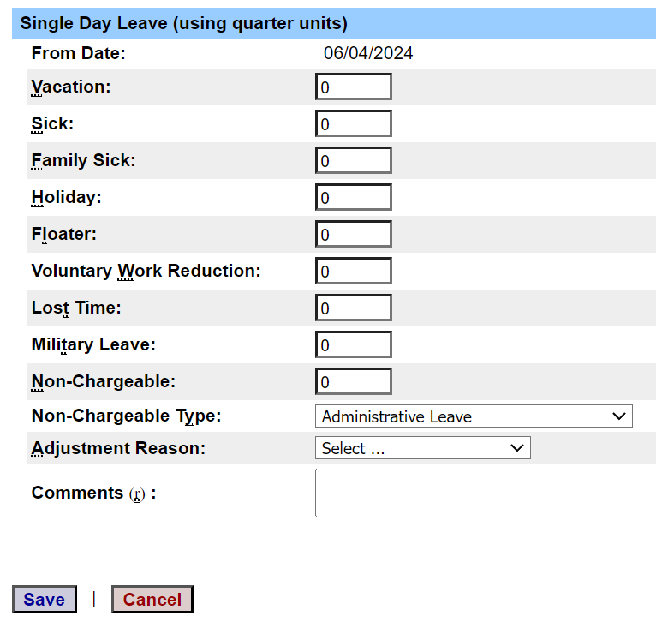
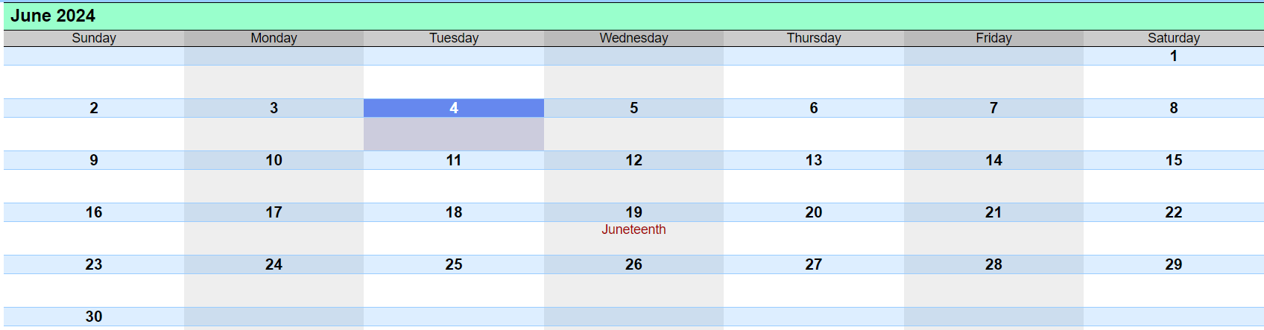

Time Record Posting
To use your accruals, click on the day you wish to charge from the calendar.
A pop up box will open which will allow you to enter a single day leave.
Please use quarter units only (.25, .50, .75, or 1).
If using Non-Chargeable time, enter the leave amount and then select the Non-Chargeable Type from the drop down selection.
If absent with an insufficient amount of accruals to use, please charge for Lost Time.
Click Save when finished.

Slide 8
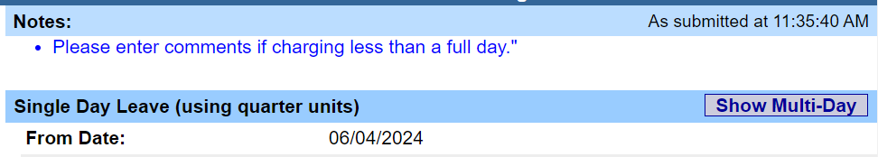
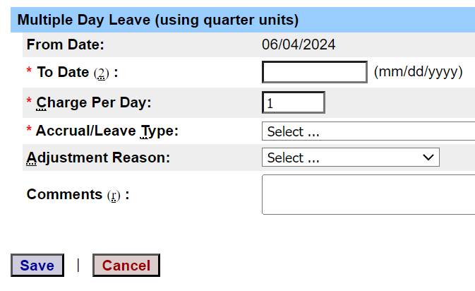
Time Record Posting
To submit multi-day requests, click on Show Multi-Day on the upper right hand corner of the pop up box.
The “From Date” will be auto-populated from the date you clicked on the calendar.
A “To Date” field will now be available to enter a date range.
Enter the Charge Per Day and select the accrual/leave type from the drop down.
TAS will automatically not include weekends in the selected date range.
Click Save when finished.

Slide 9
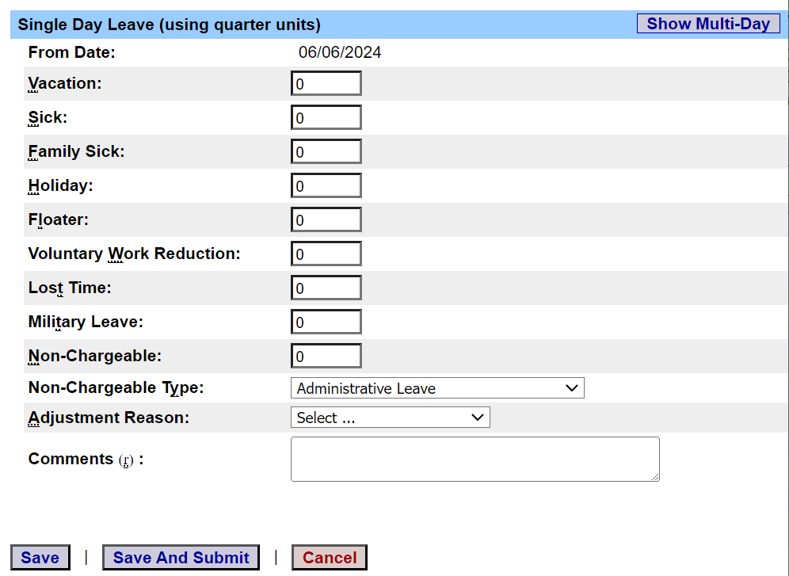
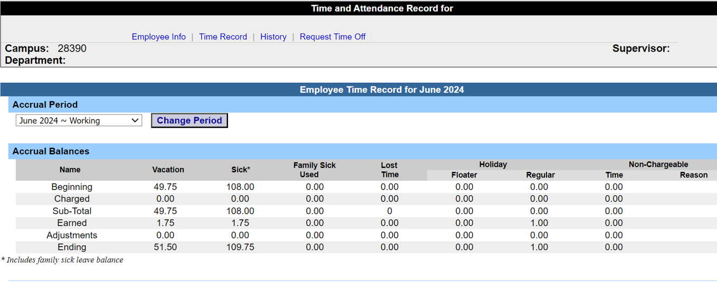
Request Time Off
To request time off in advance, click the Request Time Off tab toward the top of the time record.
Click on the day you wish to request off from the calendar.
A pop up box will open to enter a single day leave or select Show Multi-Day to enter a date range.
Please use quarter units only (.25, .50, .75, or 1).
If using Multi-Day, TAS will automatically not include weekends in the selected date range.

Slide 10
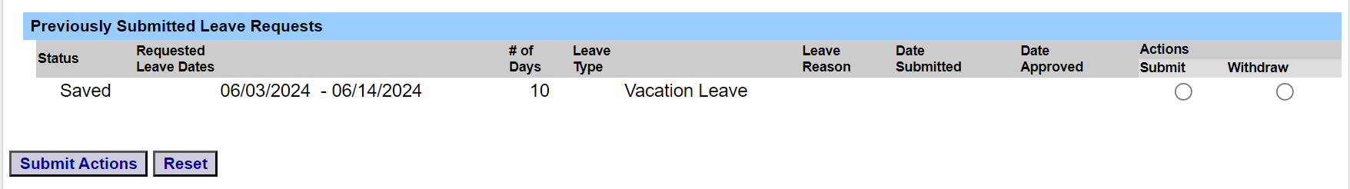
Request Time Off (Continued)
Click Save to submit the request later or click Save and Submit to send the request to your supervisor.
If Saved for later, you must return to the Request Time Off tab to find your saved request (bottom of page).
After selecting Submit or Withdraw, click Submit Actions

Slide 11
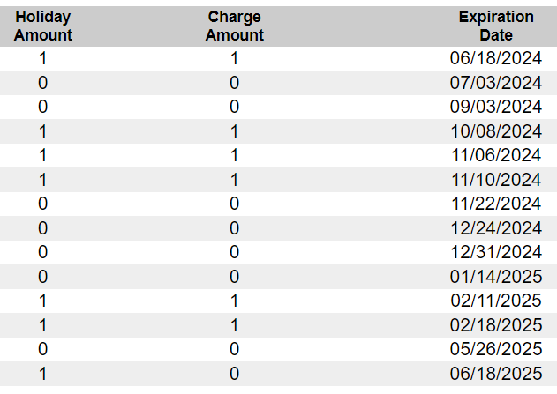
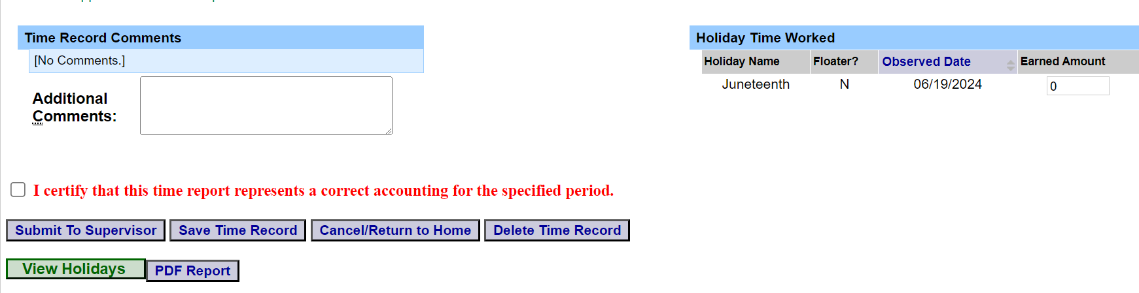

Holiday Time Worked / Regular Holidays
Holidays are set according to the campus calendar.
Regular holidays (non-floater) are not automatically earned.
If the holiday is worked, please change the Earned Amount from 0 to 1.
If the holiday is not worked, no action is needed. Leave Earned Amount at 0.
To view listing of holidays, click View Holidays at the bottom of the Time Record.
Please make sure to charge any earned holidays before the expiration date or they will be forfeited.

Slide 12
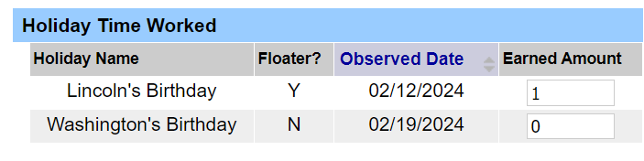
Holiday Time Worked / Floating Holidays
Floaters (Lincoln’s Birthday & Election Day) are set according to the campus calendar.
Lincoln’s Birthday is designated as a Floater (Y) which is automatically earned. Therefore, if Lincoln’s Birthday is worked, no action is needed. The Earned Amount should be set to 1 (Example shown below).
If Lincoln’s Birthday is not worked, please change the Earned Amount to 0 and Save Time Record.

Slide 13
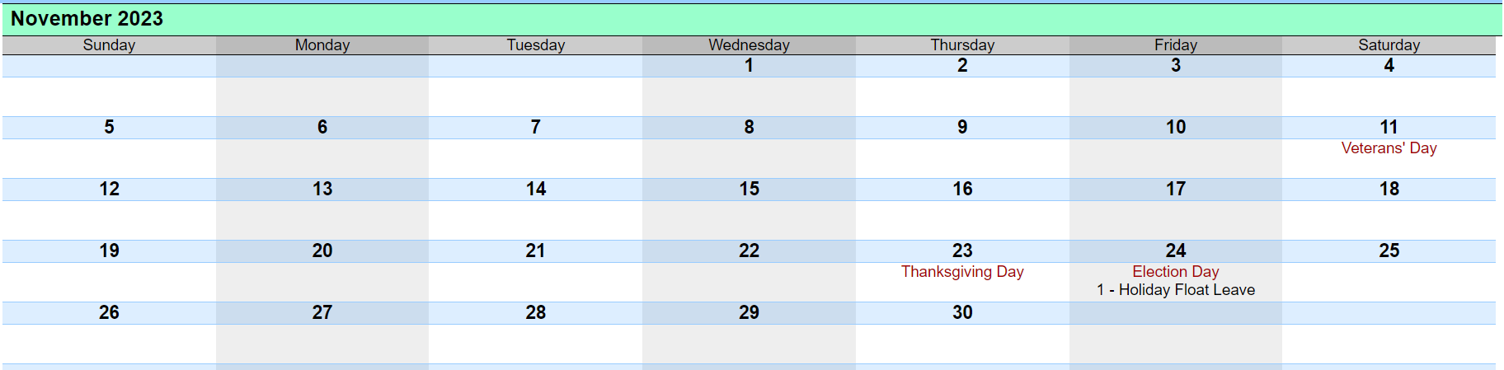
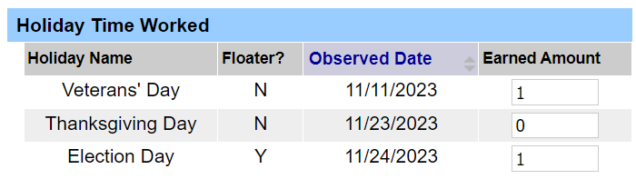
Holiday Time Worked / Floating Holidays
Floaters (Lincoln’s Birthday & Election Day) are set according to the campus calendar.
Election Day is designated as a Floater (Y) which is automatically earned. Therefore, the Earned Amount should be set to 1.
It is held on Tuesday after the first Monday in November. However, All UUP Employees are required to charge the Election Day Floater on the day after Thanksgiving (Example shown below).
If the Tuesday of Election Day is not worked, please charge the appropriate accrual on that Tuesday and still charge the floater for the day after Thanksgiving.

Slide 14
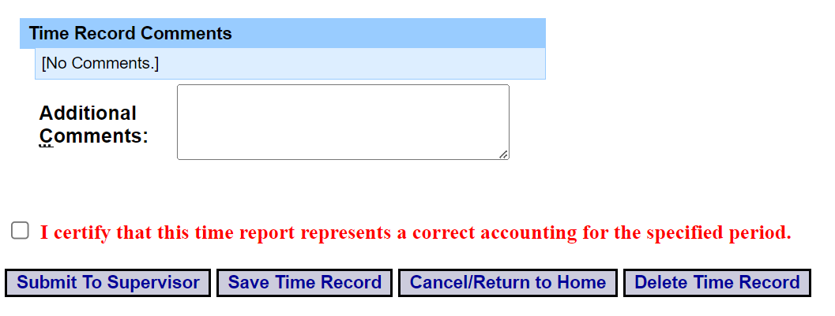
Comments
If needed, additional information can be attached to the time record by utilizing Time Record Comments (found at the bottom of the time record).
Please remember to click Save Time Record if comments are entered.

Slide 15
Conclusion
If you run into any issues, please feel free to email HR@farmingdale.edu
Remember to submit your time records at the end of each month

