Slide 1

Time and Attendance System
Supervisor Guide (Unclassified)

Slide 2
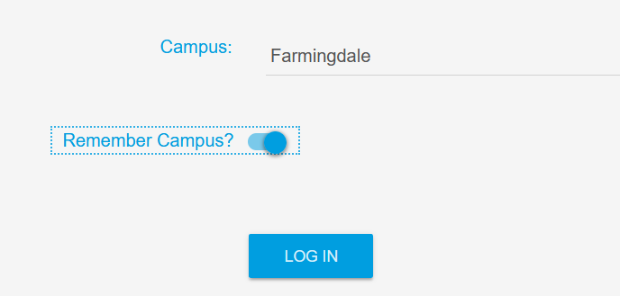
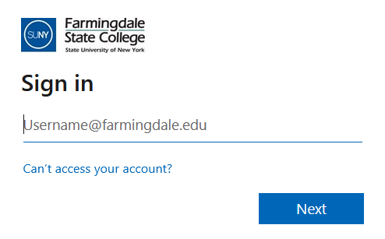

Supervisors will need to sign into the Time and Attendance System (TAS) by using the link below and entering their existing Farmingdale credentials.
https://www.suny.edu/time
Please save the login link as a “favorite” for easy access

Slide 3
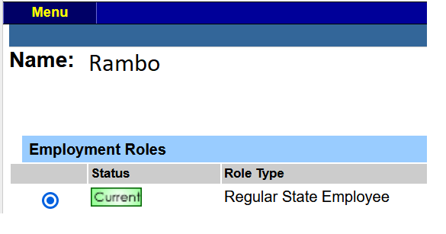


Once logged in, select Current under Employment Roles and click on Time and Attendance to access TAS.

Slide 4
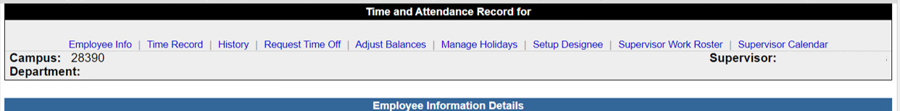
To view and approve your employees time records / time off requests, click on the Supervisor Work Roster tab.

Slide 5
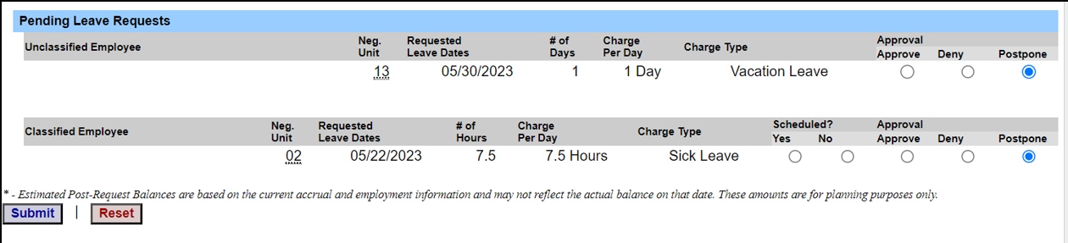
Pending Leave Requests
Supervisors need to review pending leave requests before reviewing pending time records.
When approving time off requests, please make sure to click on the bubble located below the approve column and click submit.
Once the time off request has been approved, it will feed to the employee’s time record.

Slide 6
Pending Leave Requests (continued)
If you are denying the request, click on the bubble located below the deny column.
A comment box will appear when Deny is selected, as a reason must be provided to the employee on why the time off request is being denied, click submit when finished.
The request / comment will be sent back to the employee to adjust their time record.

Slide 7
Pending Leave Requests (continued)
If you are not ready to approve a time off request, click on the bubble located below the postpone column.
The time off request will remain on your roster for approval until you are ready to review or take action.

Slide 8
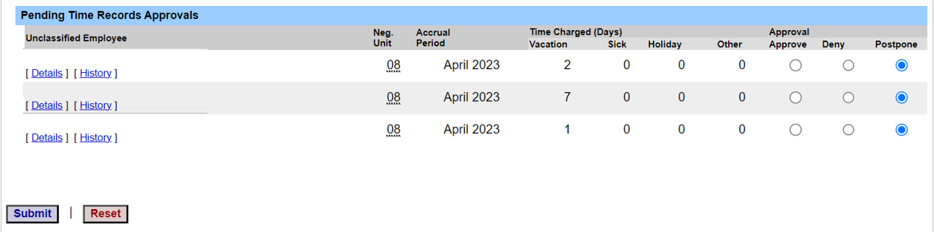
Pending Time Records Approvals
When you are ready to approve your employees time record, click on Details to view your employees time record to verify all days recorded are accurate.

Slide 9
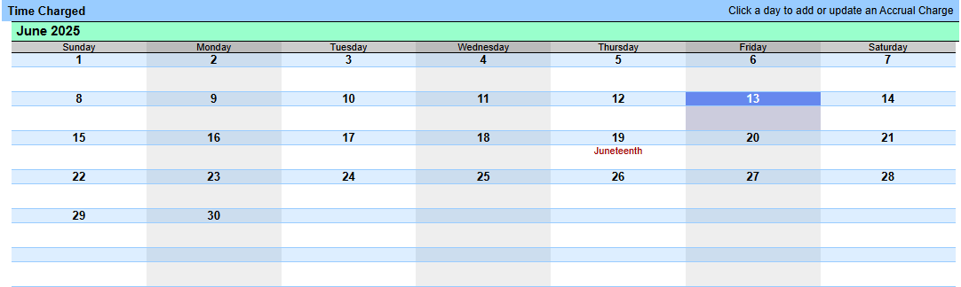
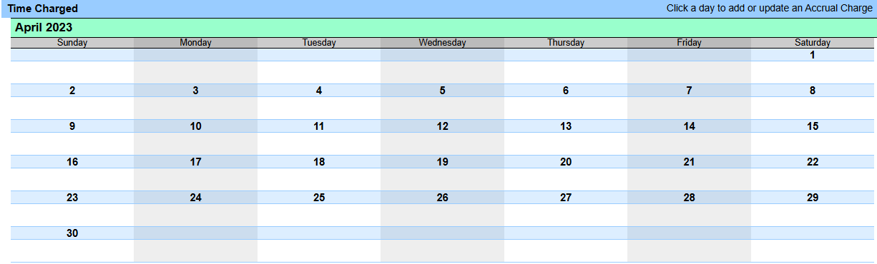
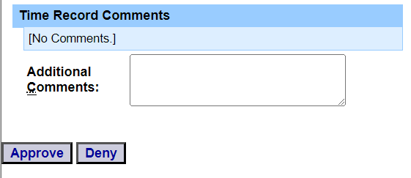
Pending Time Records Approvals (continued)
Make sure to review the entire calendar on the time record to ensure accuracy of days recorded.
If time record is accurate, click on the approve button. If you disagree with the time record, enter a comment in the box stating the reason for denying the record and click Deny. The time record will be sent back to the employee to adjust their time record.

Slide 10
Unclassified TAS Rules
The work month runs from the first day of the month to the last day of the month.
Accruals are not advanced, and may not be used before they are earned. Accruals earned in the current month are available to use on the 1st of the following month.
Timesheets are due between the 1st and the 10th of the following month. When your employee submits a time off request / time record, a message will be sent to your campus email letting you know there are pending time off requests / time records that need your attention.
If the employee does not work and charge the required amount of days per calendar month, the employee will have to charge for lost time and payroll will deduct the appropriate amount from their pay.

Slide 11

All done! For any questions or concerns, please feel free to contact Human Resources.

