Slide 1

Time and Attendance System
Supervisor Guide (Classified)

Slide 2
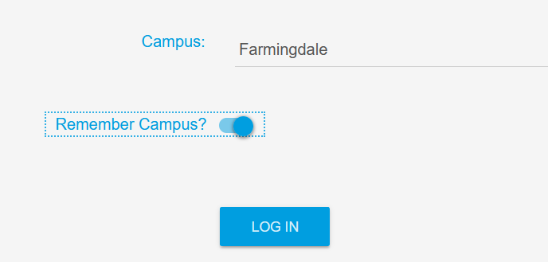
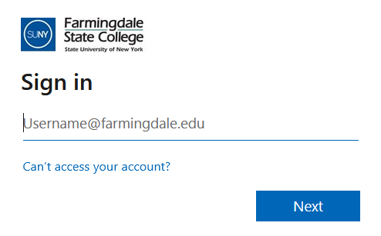
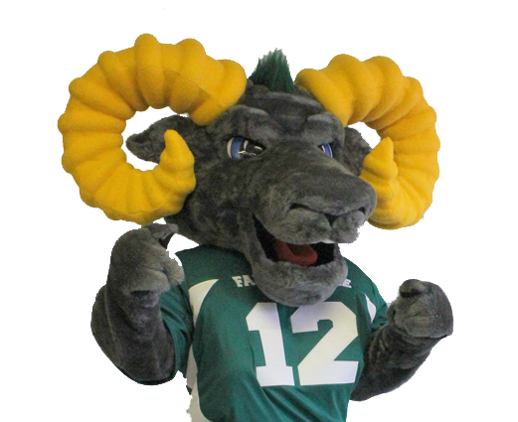
Supervisors will need to sign into the Time and Attendance System (TAS) by using the link below and entering their existing Farmingdale credentials.
https://www.suny.edu/time
Please save the login link as a “favorite” for easy access

Slide 3
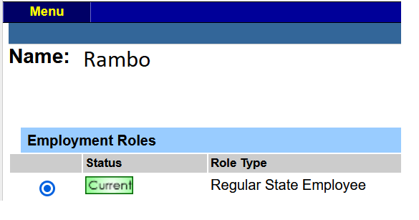


Once logged in, select Current under Employment Roles and click on Time and Attendance to access TAS.

Slide 4
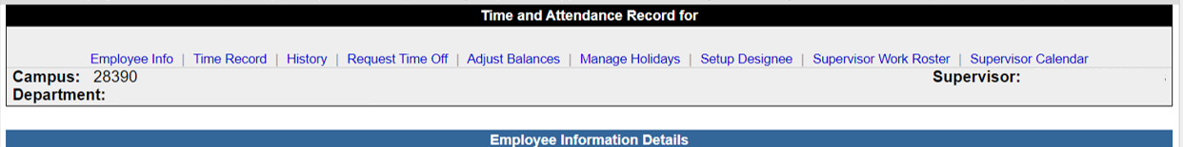
To view and approve your employees time records / time off requests, click on the Supervisor Work Roster tab.

Slide 5
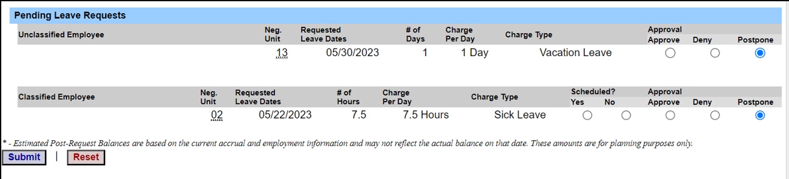
Pending Leave Requests
Supervisors need to review pending leave requests before reviewing pending time records.
When approving time off requests, please make sure to click on the bubble located below the approve column and click submit.
Once the time off request has been approved, it will feed to the employee’s time record.

Slide 6
Pending Leave Requests (continued)
If you are denying the request, click on the bubble located below the deny column.
A comment box will appear when Deny is selected, as a reason must be provided to the employee on why the time off request is being denied, click submit when finished.
The request / comment will be sent back to the employee to adjust their time record.

Slide 7
Pending Leave Requests (continued)
If you are not ready to approve a time off request, click on the bubble located below the postpone column.
The time off request will remain on your roster for approval until you are ready to review or take action.

Slide 8
Pending Leave Requests (continued)
If the employee is charging sick time, supervisors must indicate if the sick time being charged was scheduled (yes) or (no).
Scheduled sick time is when the employee has asked for the time off in advance (example = doctor’s appointment). Unscheduled sick time is when the employee calls in sick, whether it be for themselves or a family member.
When approving the time off request, make sure to click (Yes) or (No) and also click on the bubble located below the approve column, click submit when finished.

Slide 9
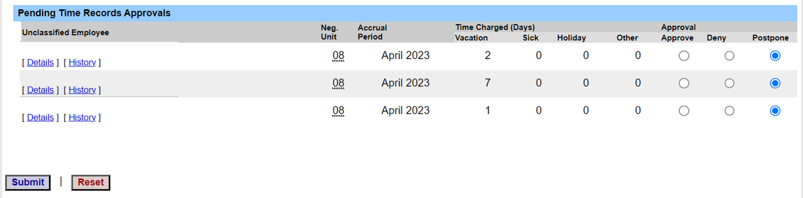
Pending Time Records Approvals
When you are ready to approve your employees time record, click on Details to view your employees time record to verify all daily in/out hours are accurate.

Slide 10
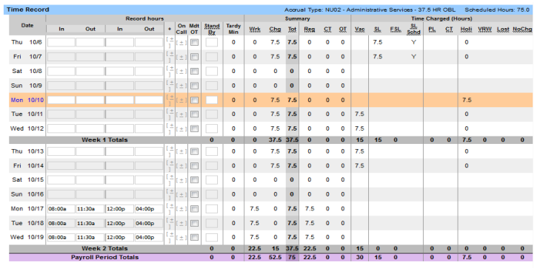
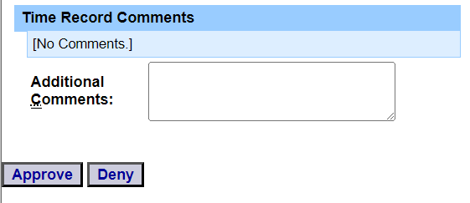
Pending Time Records Approvals (continued)
Make sure to review each day on the time record to ensure accuracy of hours.
If time record is accurate, click on the approve button. If you disagree with the time record, enter a comment in the box stating the reason for denying the record and click Deny. The time record will be sent back to the employee to adjust their time record.

Slide 11
Classified TAS Rules
The work week runs from Thursday to Wednesday.
If employee works 7.5 hours daily, their time record should equal a minimum of 37.5 hours per week and 75 hours for the pay period.
Timesheets are due Thursday, the day after the time record has ended. When your employee submits a time off request / time record, a message will be sent to your campus email letting you know there are pending time off requests / time records that need your attention.
Compensatory time is available to classified employees that work 7.5 hours daily. Any additional hours the employee works above 37.5 hours per week up to 40 hours per week will accrue compensatory time which can be used in the same manner as vacation time.
Any employee who works above 40 hours per week will earn overtime.
If the employee does not work and charge the required amount of hours per pay period, the employee will have to charge for lost time and payroll will deduct the appropriate amount from their pay.
All employees must record their 30-minute lunch break on their time record.

Slide 12

All done! For any questions or concerns, please feel free to contact Human Resources.

