Slide 1
New Employee Info Session
Payroll / Time & Attendance

Slide 2
Pay Cycle
NYS employees are paid on a two-week lag basis: a two-week delay between the time the work is performed and when the salary for that work is received.
Pay period starts on Thursday and ends two weeks later on Wednesday.
Most full-time employees are processed on an annual salary basis, paid over a period of 12 months (normally 26 pay periods)
Notes:
Notes:
Paychecks are distributed to your departments

Slide 3
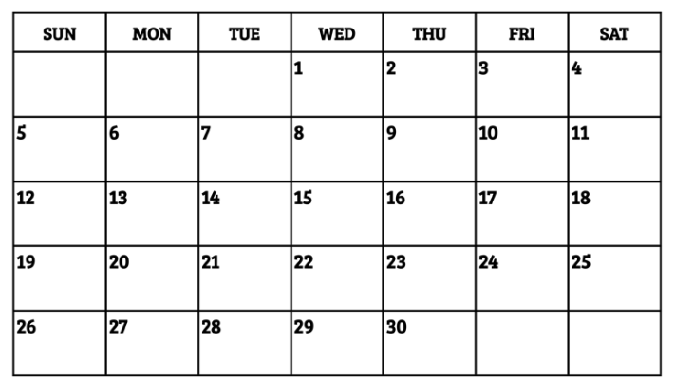
Lag Payroll
Example: If the pay period begins on the 2nd and ends on the 15th, first check would be issued on the 29th

Slide 4
The fast, convenient, and reliable way to receive your pay!
Direct deposit is available and can be split between multiple banks.
Direct deposit advice is mailed to you to show the paycheck details (salary and deductions) as well as a listing of the account(s) to which the deposit(s) were made.
If closing accounts, notify Payroll Office at least 3 weeks before check is due, or delays in receiving funds could occur.
Strongly recommend use of direct deposit, replacing lost/stolen check can take 6-8 weeks or more, especially if check was cashed.
Notes:
Notes
Paychecks and direct deposit statements are distributed to departments.
Strongly encourage direct deposit.
Your money is deposited & available beginning of business Wednesday paydays.
Lost checks (i.e., the employee who leaned over the manhole) can take 6-8 weeks to be replaced.
If on vacation or otherwise not at work on payday, immediate access to your money.

Slide 5
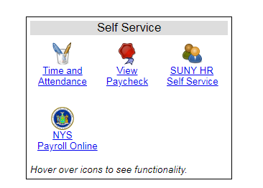
SUNY Self Service
Self Service is currently available through the SUNY portal. Features currently include:
Time & Attendance
View Paycheck
Update Address
Employees can access these functions from this website: https://www.suny.edu/hrportal

Slide 6
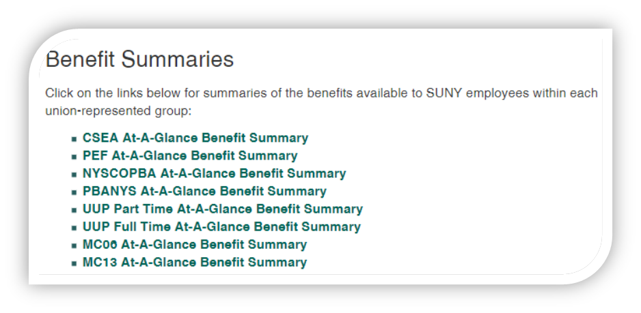
Leave Accruals
See “Benefits at a Glance” or visit the Human Resources/Benefits webpage for the accrual schedule.
Accrual balances are maintained in the Time & Attendance System
Faculty accrue sick leave only.
Professionals accrue sick and vacation leave.
Classified Service accrue sick, vacation, and personal leave.
Good news:
If you retire from state service, accrued sick leave
helps pay for your health insurance throughout
retirement!

Slide 7
Time & Attendance
All Faculty, most Professional Staff, and Administrative Classified Staff are required to submit an electronic time card through the SUNY Portal.
Professional and Faculty time cards should be submitted on a monthly basis by the 10th of each month.
Classified Administrative Staff must complete their timesheet at the end of each pay period.
10 Month Faculty are required to submit monthly time cards during their ten months of obligation (generally, August through May).

Slide 8
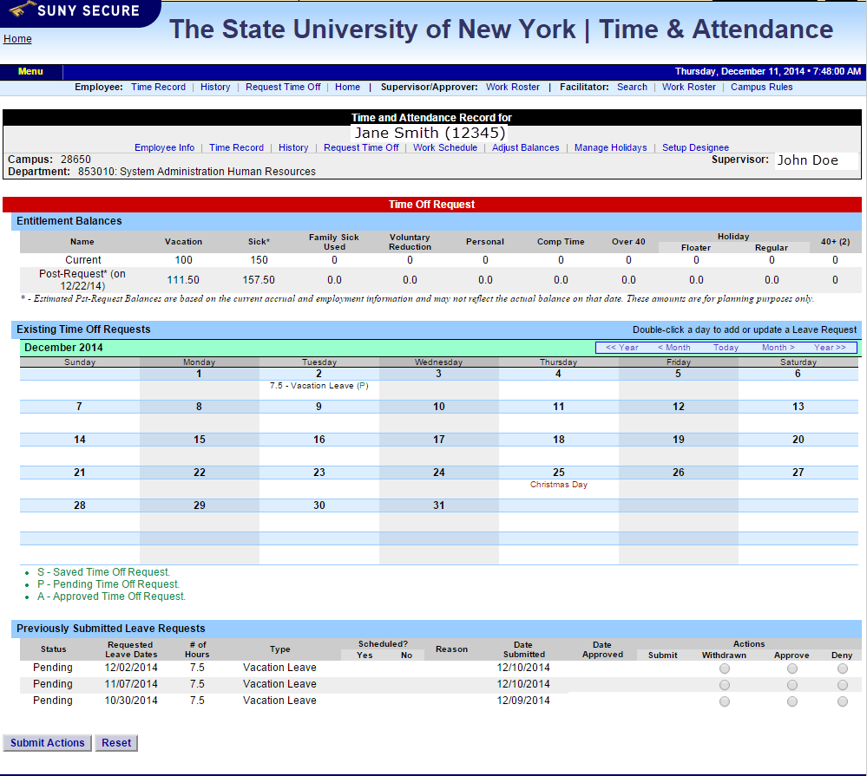
Time & Attendance
Example of monthly time record.

Slide 9
Time & Attendance
Example of hourly time record.

Slide 10
Questions?
Benefits Questions? Email: benefits@farmingdale.edu
Human Resources Questions? Email: hr@farmingdale.edu

