Slide 1


Time and Attendance System
UUP 10 Month Faculty & Adjunct Faculty

Slide 2

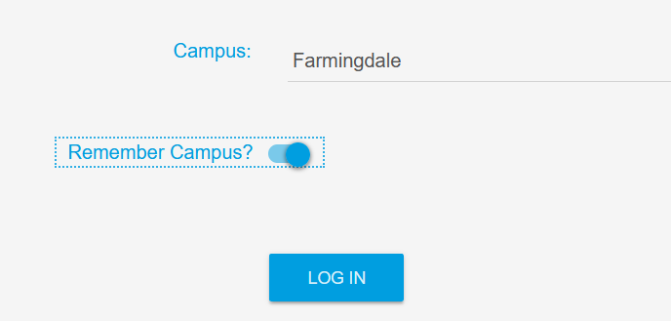
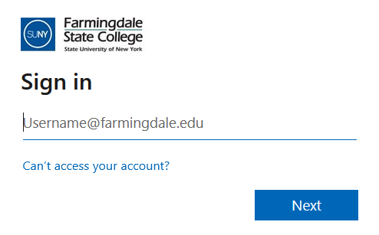


Access
To access the Time & Attendance System (TAS), please use the following link: https://www.suny.edu/time
Please save the login link as a “favorite” for easy access
Login information will be the same as your Farmingdale email credentials.

Slide 3
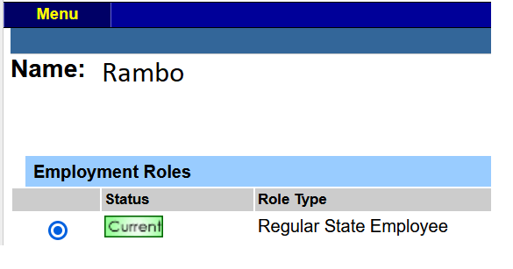

Time Record
Once logged in, select Current under Employment Roles and click on Time and Attendance to open your Time Record.

Slide 4
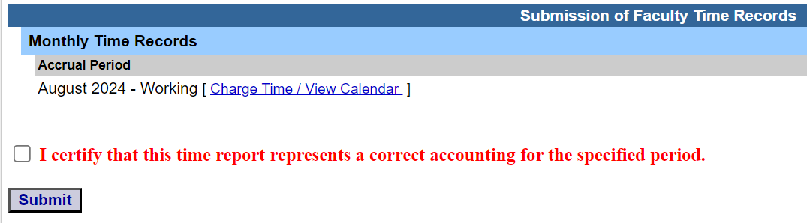
Time Record / Accrual Period
Your first “Working” time record should appear by default.
If there are no days to charge at the end of the month, please certify and Submit
Otherwise, to charge time, please click on [Charge Time / View Calendar]

Slide 5
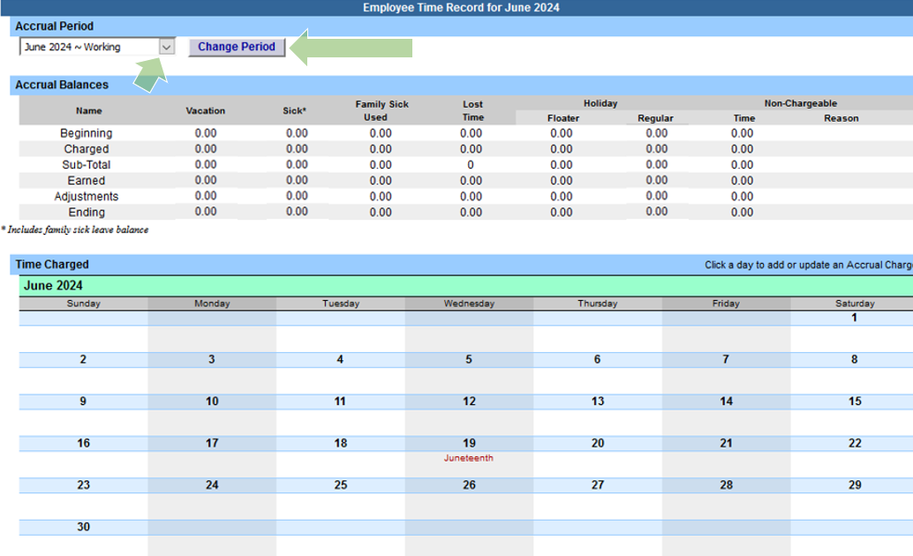
Time Record / Accrual Period
A calendar view of the “Working” time record will be displayed.
You may change the Accrual Period (month) by clicking the drop down menu, selecting a month, and clicking Change Period

Slide 6
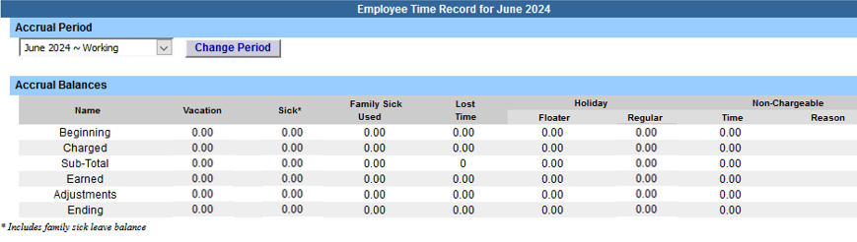
Time Record / Accrual Balances
Beginning = The amount of sick time available for use (10 Month Faculty & Adjunct Faculty are eligible to accrue sick leave credits only)
Charged = The amount of time being charged.
Sub-Total = The difference between the beginning balance after charged time.
Earned = Accrual earned at the end of the month (Accruals cannot be used in the same month they are earned).
Adjustments = Updates made by HR.
Ending = Beginning balance available at the start of the next month.

Slide 7
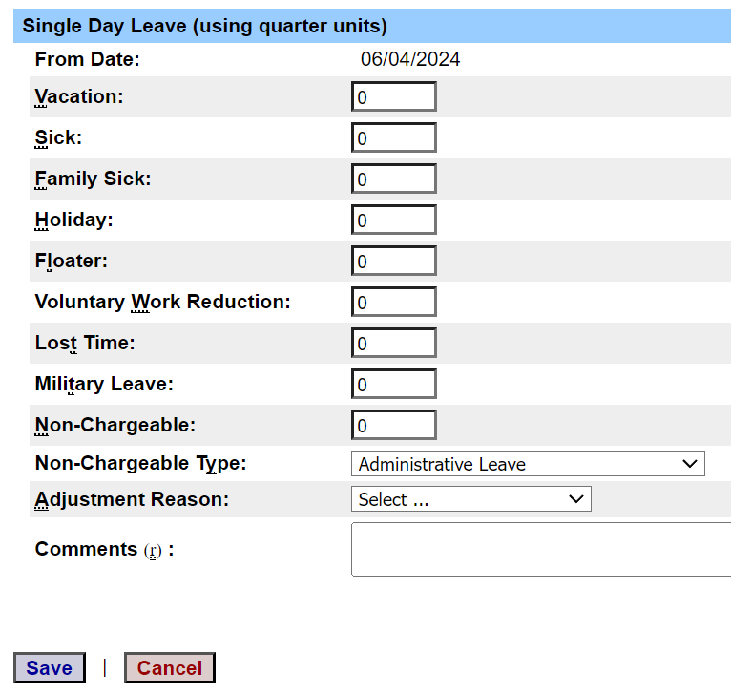
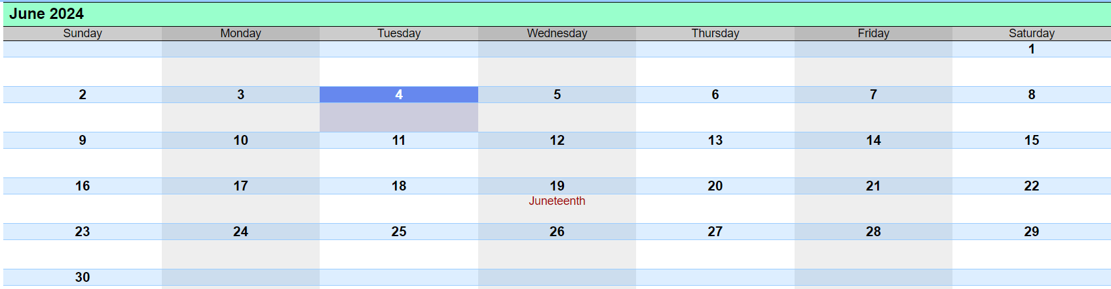

Time Record Posting
To use your accruals, click on the day you wish to charge from the calendar.
A pop up box will open which will allow you to enter a single day leave.
Please use quarter units only (.25, .50, .75, or 1).
If using Non-Chargeable time, enter the leave amount and then select the Non-Chargeable Type from the drop down selection.
If absent with an insufficient amount of accruals to use, please charge for Lost Time.
Click Save when finished.

Slide 8
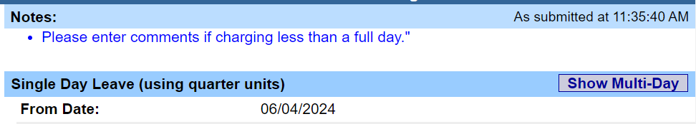
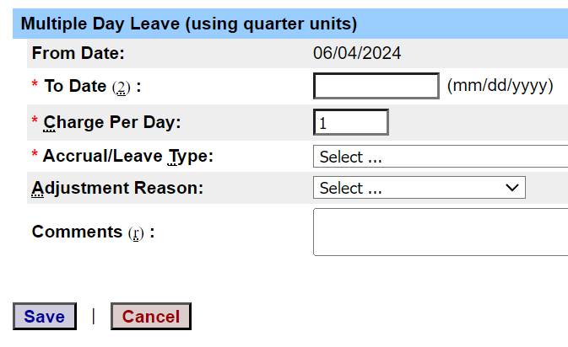
Time Record Posting
To submit multi-day requests, click on Show Multi-Day on the upper right hand corner of the pop up box.
The “From Date” will be auto-populated from the date you clicked on the calendar.
A “To Date” field will now be available to enter a date range.
Enter the Charge Per Day and select the accrual/leave type from the drop down.
TAS will automatically not include weekends in the selected date range.
Click Save when finished.

Slide 9
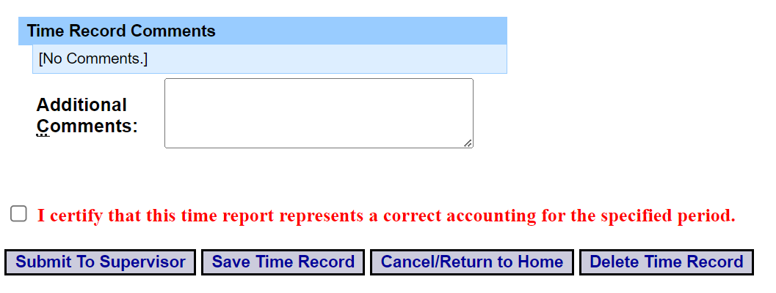
Comments
If needed, additional information can be attached to the time record by utilizing Time Record Comments (found at the bottom of the time record).
Please remember to click Save Time Record if comments are entered.

Slide 10
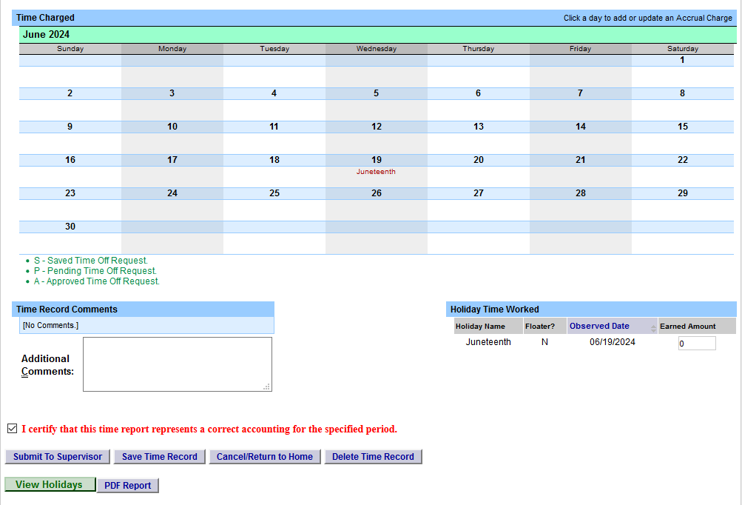
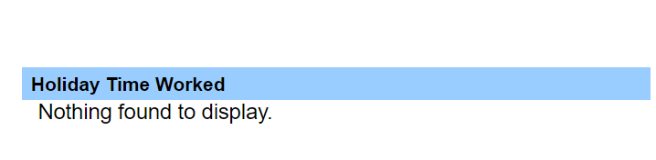
Time Record
As a reminder, time records are due at the end of each month.
When you’re ready to submit, please click certify and then click Submit To Supervisor

Slide 11
Conclusion
If you run into any issues, please feel free to email HR@farmingdale.edu
Remember to submit your time records at the end of each month

