Slide 1

Student Assistant / College Work Study Guide

Slide 2



To access Interview Exchange, employees should use the following link: https://www.interviewexchange.com/login.jsp
IE uses Single Sign On (SSO). The email login is your Farmingdale email address and your password will be the same as your Farmingdale network account.
For any errors with login, please email studentpayroll@farmingdale.edu
Please save the login link as a “favorite” for easy access

Slide 3
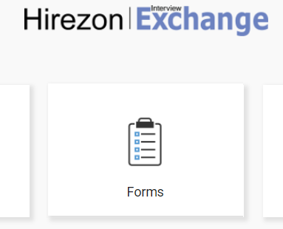

After login, select the “Forms” module to access the system.

Slide 4
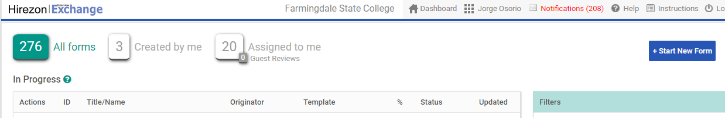

Toward the top right corner of the page, click on “Start New Form”.

Slide 5
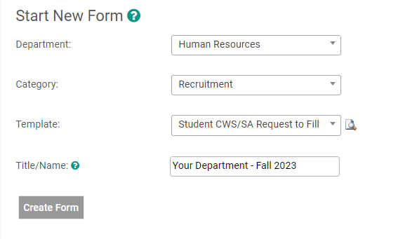

  Department = Select your department
  Category = Recruitment
  Template = Student CWS/SA Request to Fill
  Title/Name = Department – Semester/Year
  Click “Create Form”
*Departments only require one Request to Fill per semester

Slide 6
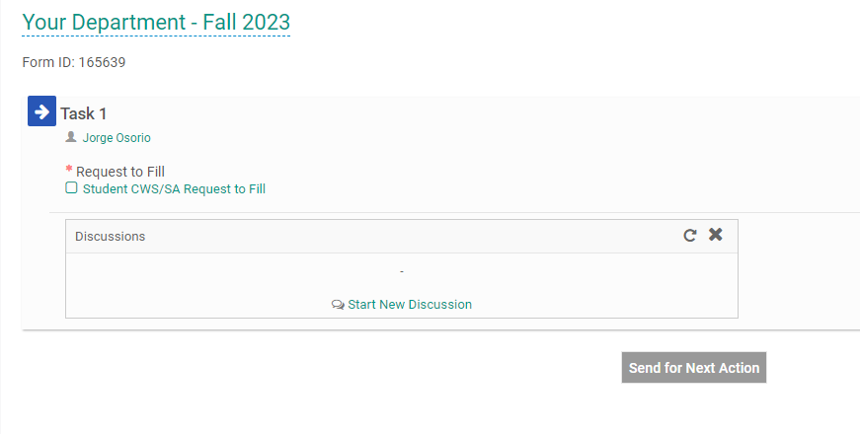
From this screen, click on the words “Student CWS/SA Request to Fill” to open the form.

Slide 7
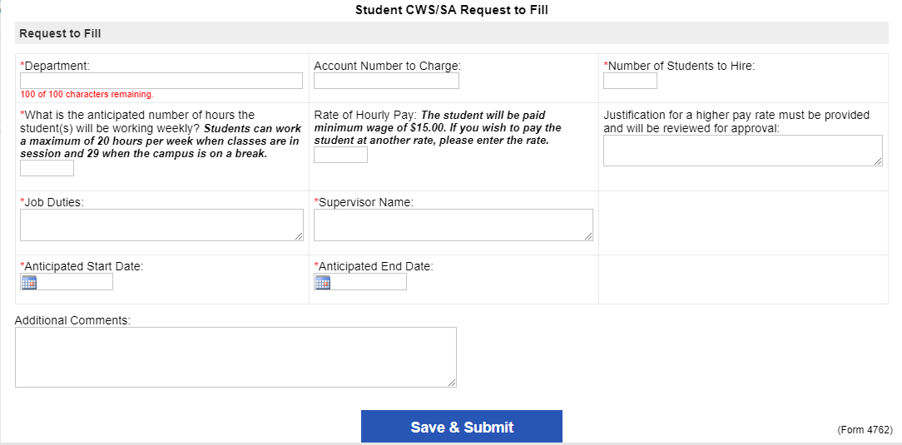

Please complete form.
All fields with a red * are required.
For pay rates higher than $15/hr, please provide a justification for review.
Click “Save & Submit” once finished. The form will refresh, click on “Continue” to proceed.

Slide 8
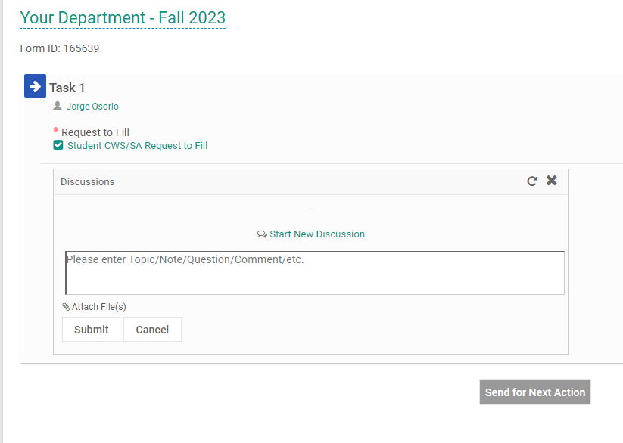

The “Student CWS/SA Request to Fill” form should now appear with a green checkmark.
If needed you may attach a document by clicking on “Start New Discussion”, followed by clicking on “Attach File(s)”.
You may now click “Send for Next Action” to send for routing!

Slide 9
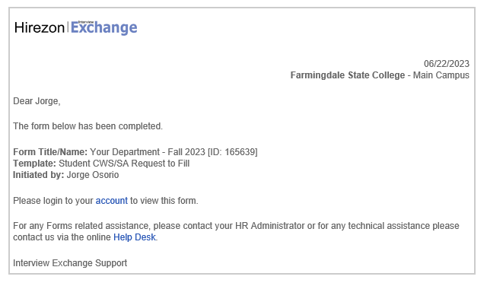

Once the Request to Fill form is approved and completed, the originator of the form will receive an email from Interview Exchange.
Upon approval, you will need to complete an Appointment Notice for each student you are hiring for your department.

Slide 10
To create the appointment notice(s), sign-in to Interview Exchange.
Toward the top right corner of the page, click on “Start New Form”.

Slide 11
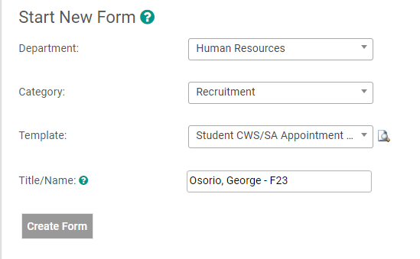

  Department = Select your department
  Category = Recruitment
  Template = Student CWS/SA Appointment Notice
  Title/Name = Student Last Name, First Name – Semester/Year
  Click “Create Form”

Slide 12
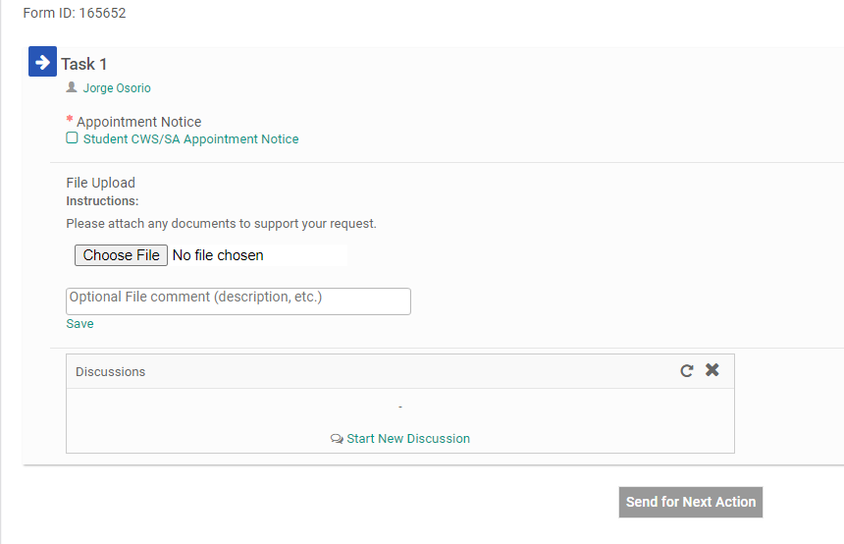
From this screen, click on the words “Student CWS/SA Appointment Notice” to open the form.

Slide 13
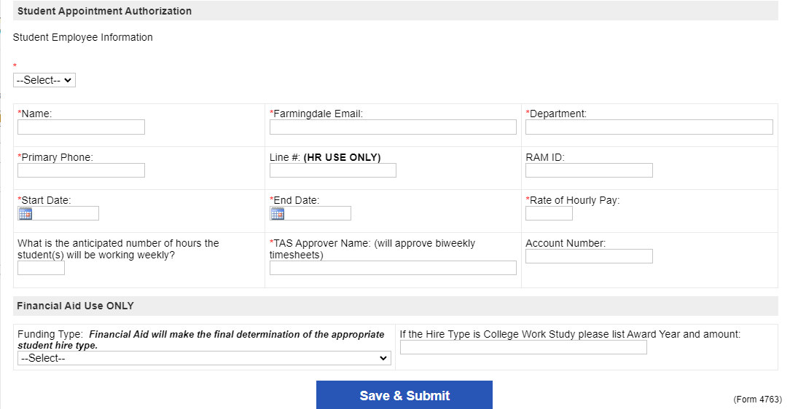
Please complete form.
All fields with a red * are required.
Click “Save & Submit” once finished. The form will refresh, click on “Continue” to proceed.

Slide 14
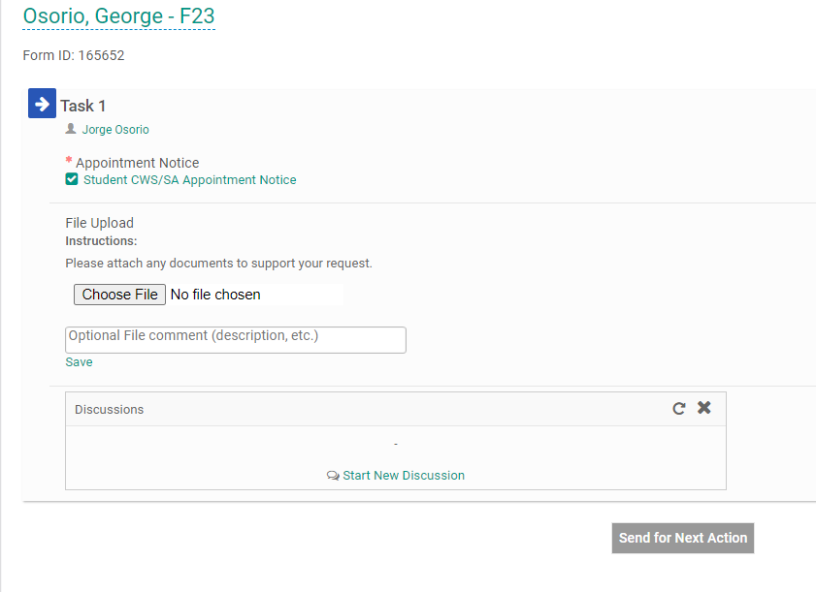
The “Student CWS/SA Appointment Notice” form should now appear with a green checkmark.
If needed you may attach a document by clicking on “Choose File”.
You may now click “Send for Next Action” to send for routing!

Slide 15

All done! If you run into any issues, please feel free to email Student Payroll at studentpayroll@farmingdale.edu

