Slide 1
Performance Forms
How to complete the Performance Forms
using Interview Exchange

Slide 2
What are the Performance Forms?
There are 2 Performance Forms that are now located in Interview Exchange:
  The Annual Professional Performance Program. (Created by Supervisor)
  The Annual Professional Evaluation. (Created by Supervisor)

Slide 3
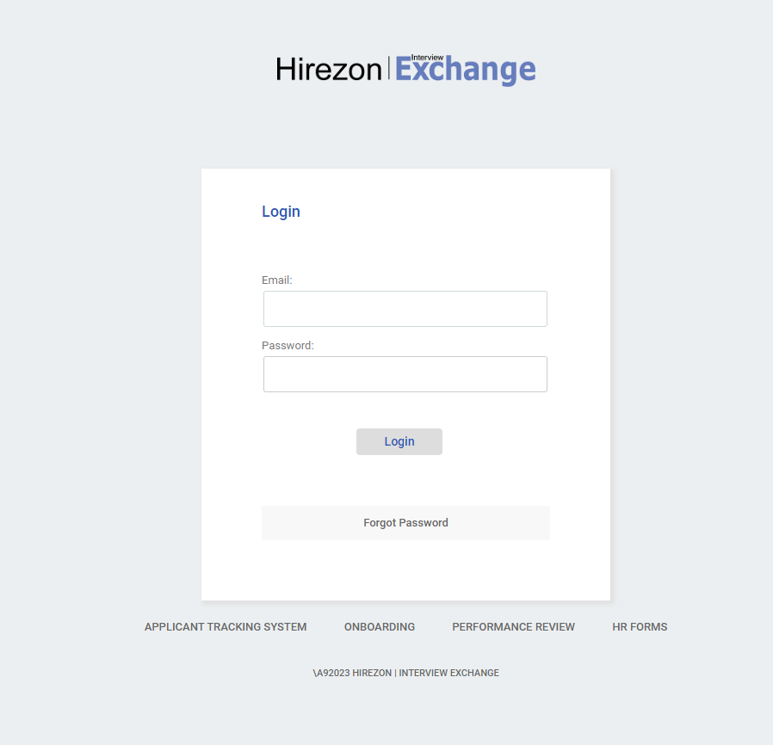
Logging into Interview Exchange
Log in by using the link below: https://www.interviewexchange.com/login.jsp
Once you create a Hirezon account, your username and password are your FSC credentials (single sign-on).
Please note, while creating your account you will be asked for your address. Please use FSC’s address.
  2350 Broadhollow Road, Farmingdale, NY 11735

Slide 4
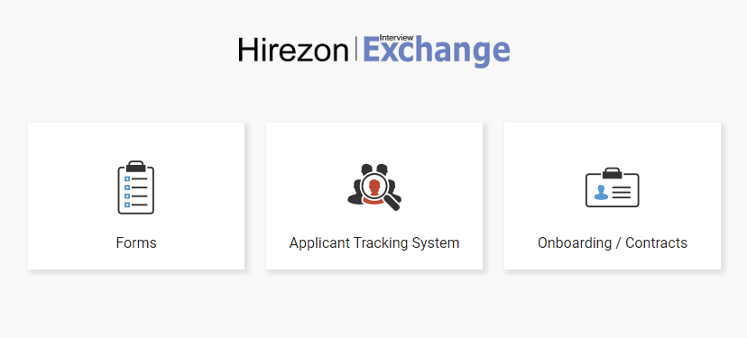

Navigating Interview Exchange
Once you have logged in to Interview Exchange you will need to click on the Forms tab.

Slide 5

Creating a New Form
Once you have clicked on the Forms tab, in the top right corner of your screen you will see a blue box that says “Start New Form.”
The 4 categories necessary to create a new form are:
  Department: Select the department the employee works in.
  Category: Select “Performance.”
  Template: Select the type of form you would like to complete.
  Title/Name: Fill in the employee’s name and the title of the form you are filling out.
    e.g.: “Smith, John – 2023-2024 Performance Program.”

Slide 6
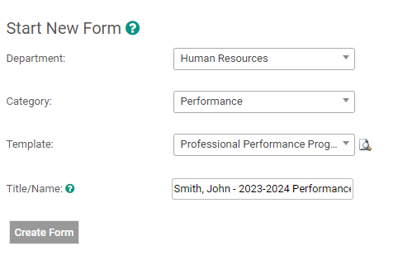


Performance Programs and Evaluations Must Be Created by The Employee’s Supervisor
Select the Employee’s Department
Select “Performance”
Select the form you would like to complete
Enter Employee’s Name and the form name
e.g.: “Smith, John – 2023-2024 Performance Program”
Once all the categories are filled in, click “Create Form.”

Slide 7
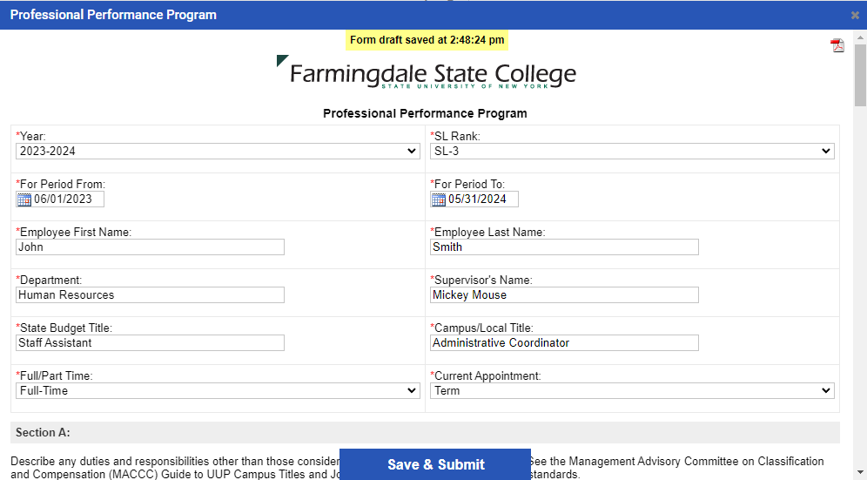
Completing The Professional Performance Program
This form must be created by the employee’s supervisor.
When filling out the time period, please select June 1, 2023 to May 31, 2024.
Once the supervisor has completed the form, they will apply their signature to the bottom of the form, click “Save & Submit” then “Continue”.
The form will then be routed to the employee for review and signature. (see slide 9 for routing instructions)
A member of the Human Resources department will be notified of the completion of the form and will file in the employee’s personnel file.

Slide 8
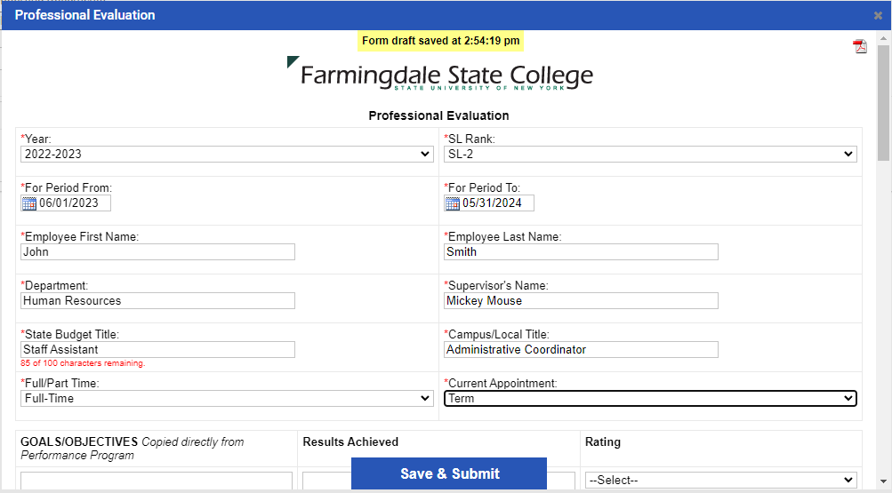
Completing The Professional Evaluation
This form must be created by the employee’s supervisor.
When filling out the time period, please select June 1, 2022 to May 31, 2023.
Once the supervisor has completed the form, they will click “Save & Submit” then “Continue”.
The form will then be routed to the employee for review and acknowledgement. (see slide 9 for routing instructions)
A member of the Human Resources department will be notified of the completion of the form and will file in the employee’s personnel file.

Slide 9
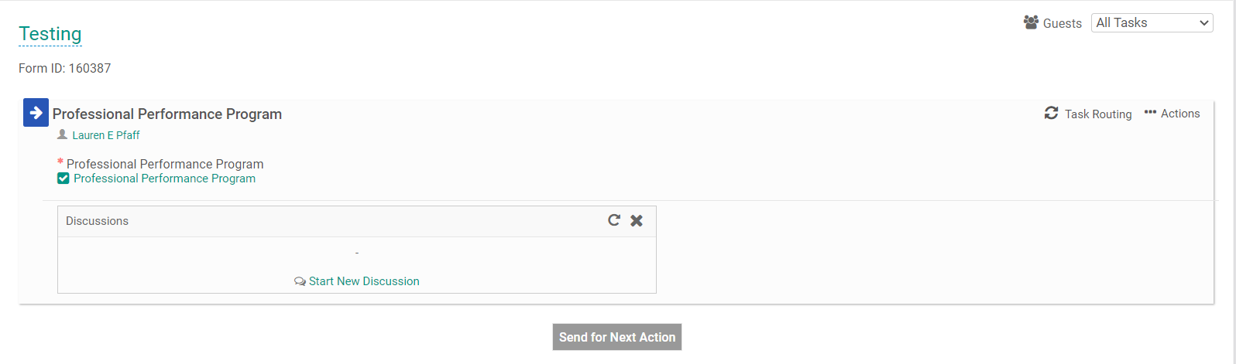

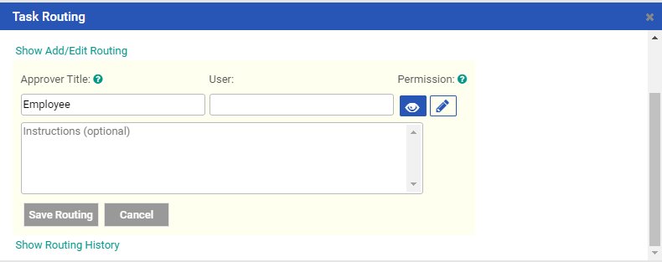


Routing the Professional Performance Program and Evaluation
For Supervisor's Only
Once you have completed the form, click "Task Routing" on the right-hand side.
Click on the pencil icon in the “Actions” section add employee to routing for review.
Type the employee's name in the "User" box.
Select their name from the drop-down menu when it appears.
Then, click the "pencil" Icon.
  This will give the employee access to sign the form.
  Make sure both the "eye" and "pencil" icons are both blue.

Slide 10
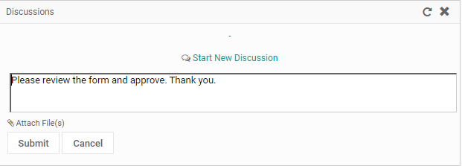
Continued
Routing the Performance
Program and Evaluation
For Supervisor's Only
Select “Start New Discussion”, in the text box outline what the employee needs to do to complete the form.
  Performance Program e.g.: “Please review the form and approve. Thank you.”
  Evaluation e.g.: "Please review the form, sign and approve. Thank you."
Once those steps are complete, the routing on your screen should look like the photo on the right.
Then click the “Submit" button.

Slide 11
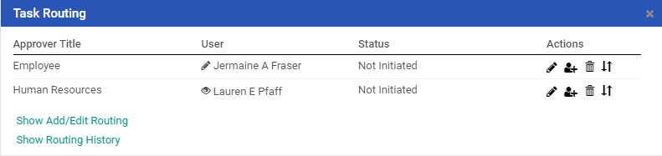
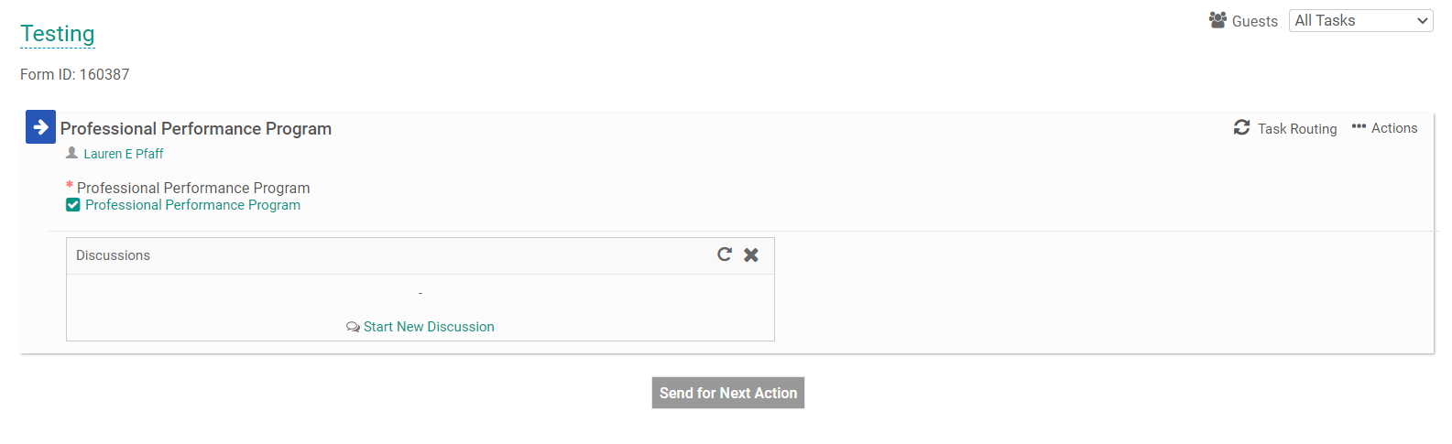
Continued
Routing the Performance
Program and Evaluation
Employee’s Name will be here
HR employee’s name will be here
For Supervisor's Only
Once the routing is saved, your screen should look like the photo on the top right.
The final step is to click the "Send for Next Action" button.
By doing that, it will alert the employee that the form is in their workflow.

Slide 12
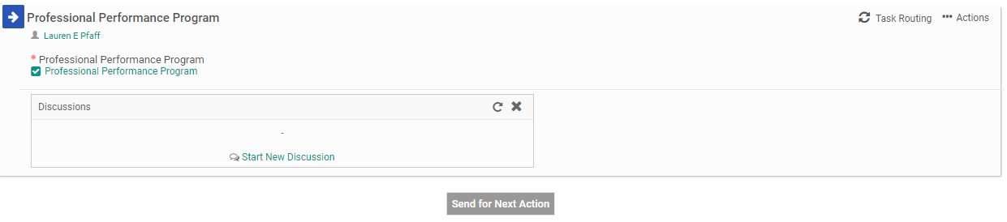
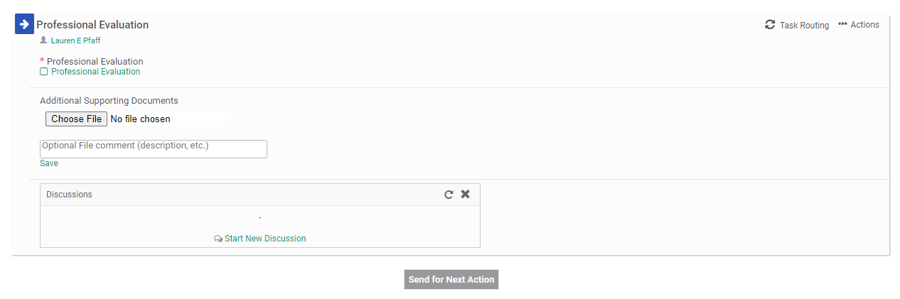

Approving Forms
Performance Program
For the Performance Program, the first step is to review the form.
Once you have reviewed it, please apply your signature, then click the “Send for Next Action” button. The form has now been sent to the next reviewer.
For the Evaluation, The first step is to review the form.
Once you have reviewed it, At the bottom of the form, please “sign” in the “Employee Name” box.
Once you have reviewed it, please click the “Send for Next Action” button. The form has now been sent to the next reviewer.
Evaluation

Slide 13
Thank you for watching!
Should you have any questions, please feel free
to contact Human Resources at HR@farmingdale.edu

