Slide 1

Student CWS / SA Appointment Notice
Guide

Slide 2



To access Interview Exchange, employees should use the following link: https://www.interviewexchange.com/login.jsp
IE uses Single Sign On (SSO). The email login is your Farmingdale email address and your password will be the same as your Farmingdale network account.
For any errors with login, please email studentpayroll@farmingdale.edu
Please save the login link as a “favorite” for easy access

Slide 3
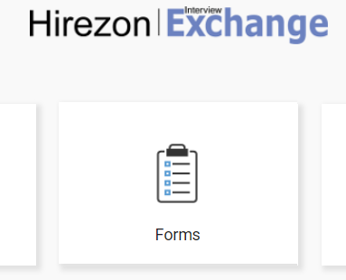

After login, select the “Forms” module to access the system.

Slide 4
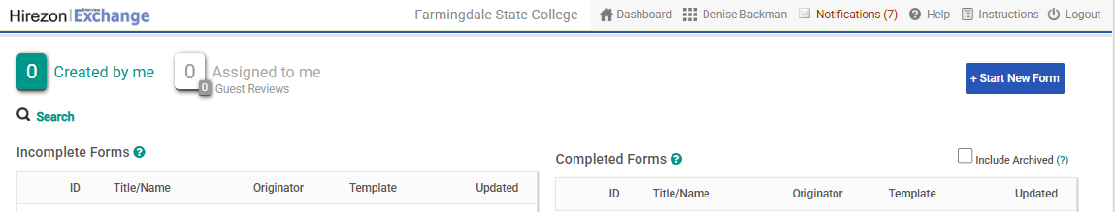

Toward the top right corner of the page, click on “Start New Form”.

Slide 5
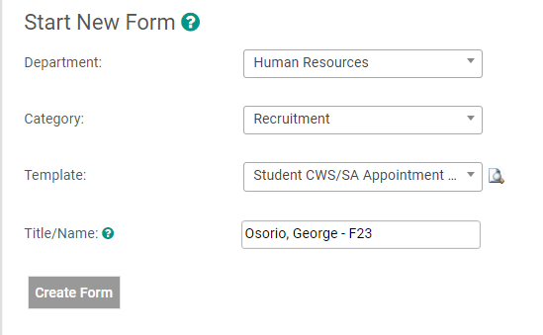


  Department = Select your department
  Category = Recruitment
  Template = Student CWS/SA Appointment Notice (Scroll down the drop-down options to find)
  Title/Name = Student Last Name, First Name – Semester/Year
  Click “Create Form”
Fall = F Spring = Sp Summer = Su
Followed by last 2 digits of Semester Year

Slide 6
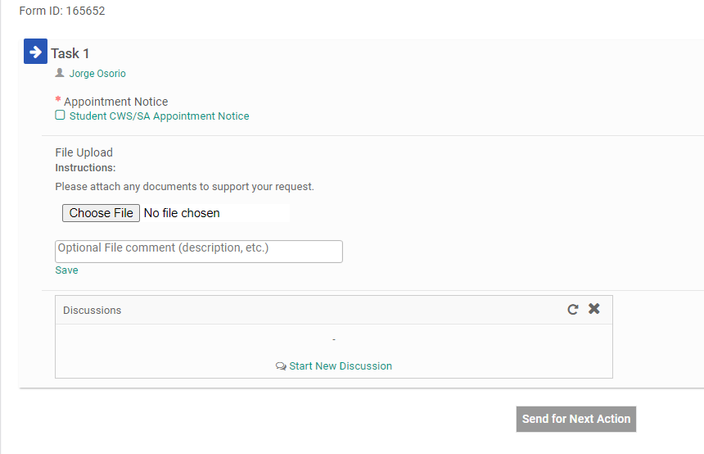
From this screen, click on the words “Student CWS/SA Appointment Notice” to open the form.
Originator

Slide 7
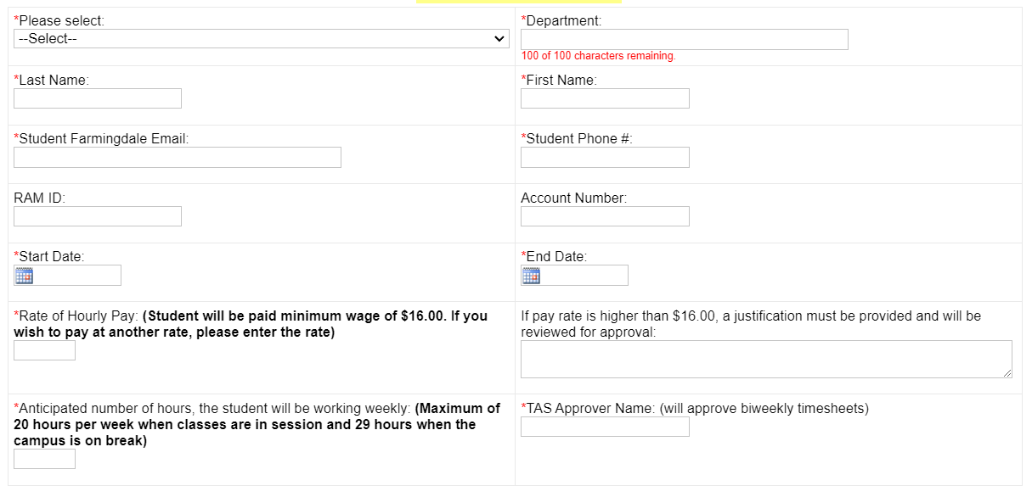
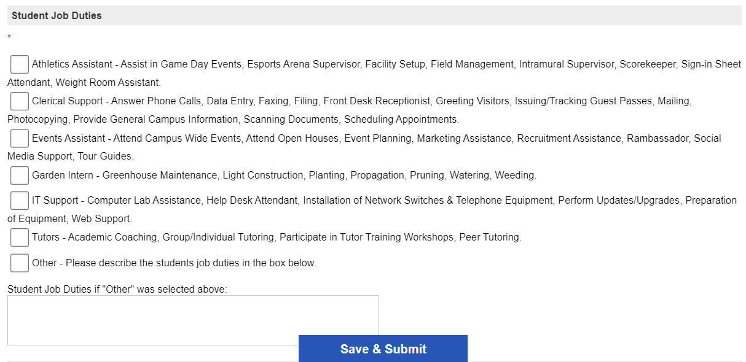

Please complete form.
All fields with a red * are required.
If pay rate is higher than minimum wage ($16.50), a justification must be provided.
Multiple job duties can be selected. If a job duty does not match, please select “Other” and provide description in the box below.
Click “Save & Submit” once finished.
The form will refresh, click on “Continue” to proceed.

Slide 8
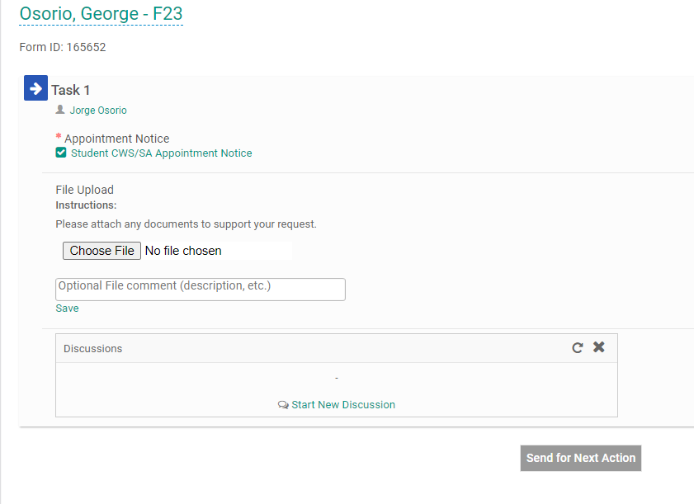

The “Student CWS/SA Appointment Notice” form should now appear with a green checkmark.
If needed you may attach a document by clicking on “Choose File”.
You may now click “Send for Next Action” to send for routing!
Last Name, First Name- Semester/Year
Originator

Slide 9

All done! If you run into any issues, please feel free to email Student Payroll at studentpayroll@farmingdale.edu

