Slide 1
SUNY HR Time & Attendance System Training For Faculty
WELCOME

Slide 2
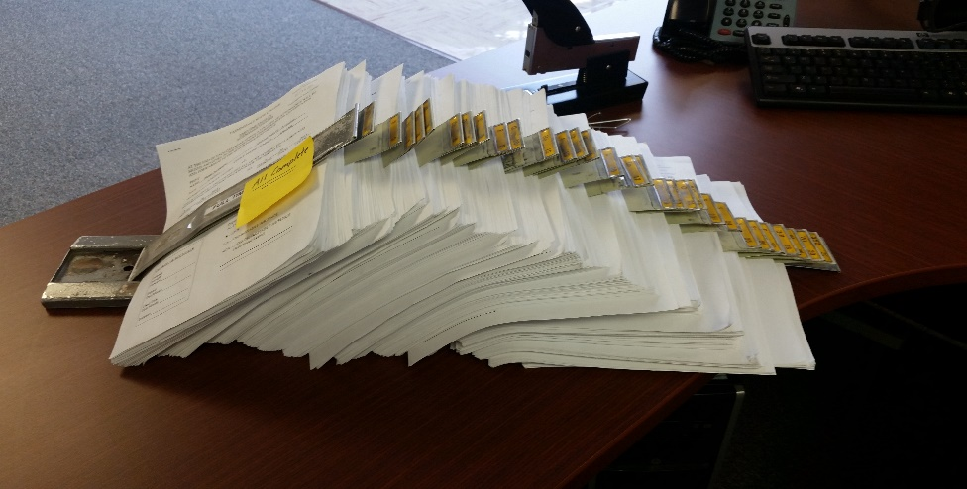
The new electronic Time & Attendance System (TAS) will replace the paper Attendance Vouchers !
No more paper!
More accurate record keeping
The ability for employees to view their sick time balances
Quick and easy to use
Have I mentioned…..No more paper!!!!
All Faculty will be responsible for recording their time electronically as of February 2016

Slide 3
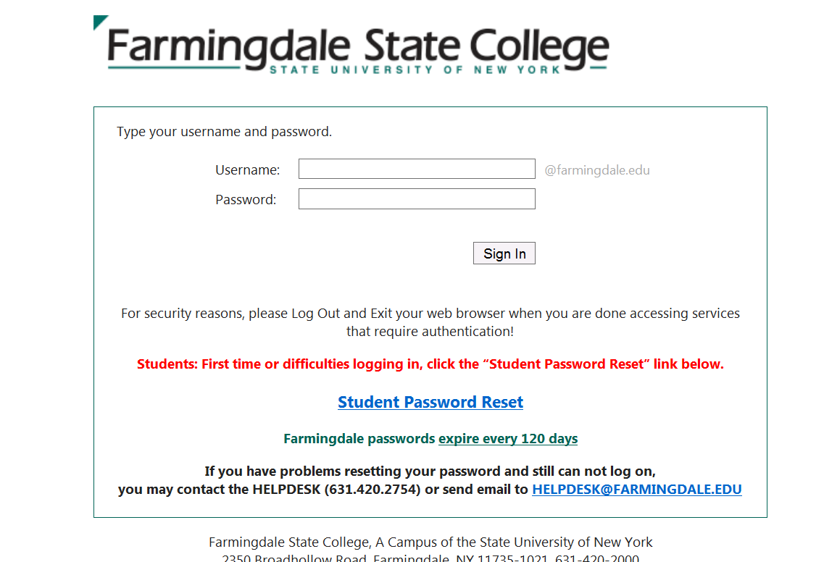
Signing On
Access the TAS through the link:
https://www.suny.edu/time
Enter the same user name and password that you use to log onto your Farmingdale computer

Slide 4
Signing On
Click Time & Attendance
Click Time & Attendance

Slide 5
Accessing Your Monthly Time Record
If no sick time was used in the month, click on the attestation box then the submit box. This will send your time record to your supervisor electronically. No changes can be made to a time record once it has been submitted to you supervisor.
To access the monthly time record, click on Charge Time/View Calendar

Slide 6
If you click on the Time Record, the monthly calendar will open up
You sick balance will appear at the top of the screen

Slide 7
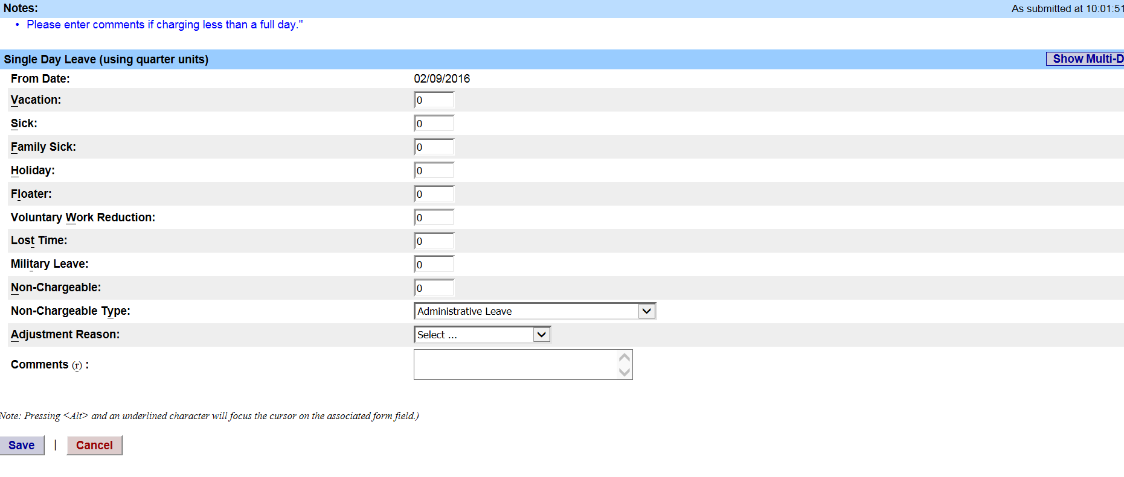
Charging Sick Time
Double click on any day that sick time should be charged. A box will pop up over the calendar.

Slide 8
Charging Sick Time
Key in a “1” next to Sick or Family Sick. Then click SAVE at the bottom of the screen

Slide 9
Charging Sick Time
The sick day will appear on the calendar. Repeat for any additional sick days to be charged for the month.
ALWAYS click on Save Time Record

Slide 10
Marking Non-Chargeable Time
The system has the ability to track non-chargeable time such as conference days
Mark a “1” in the box
non-chargeable
Select the type of non-chargeable time from the drop down box
ALWAYS click Save
Non-chargeable time would include things such as jury duty, conference days, off campus meeting, presidential sick leave, etc.

Slide 11
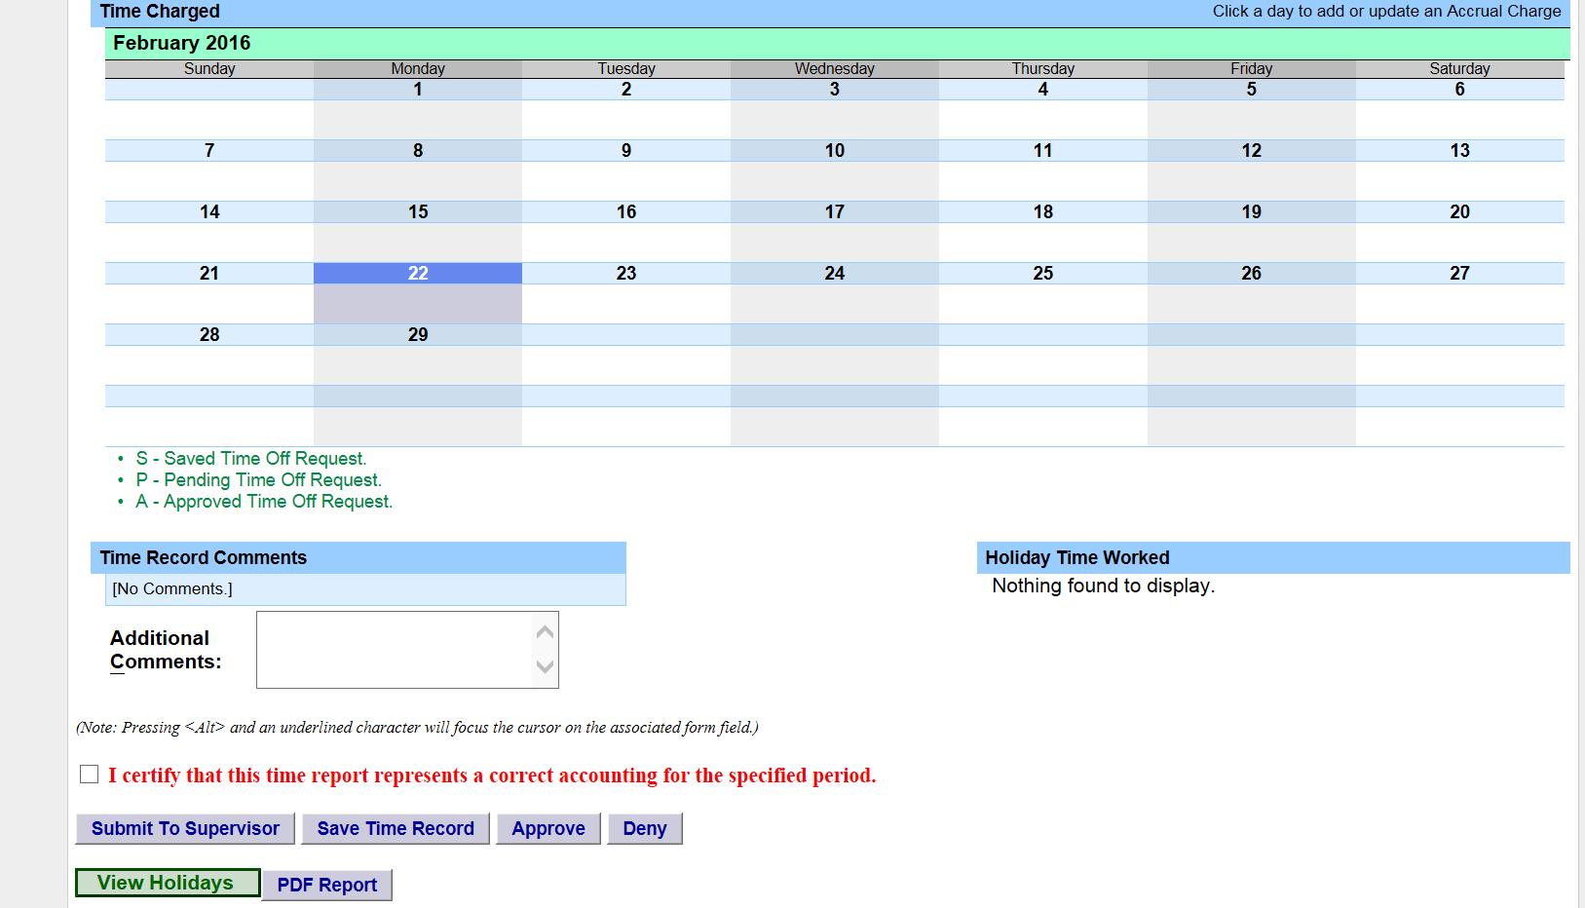
Submitting The Time Record
When the time record is completed, it must be submitted to your supervisor. Click on the attestation box then the submit box. This will send your time record to your supervisor electronically.

Slide 12
After Submitting Your Time Record
If you submitted your time record successfully, you will see a confirmation at the bottom of your screen.

Slide 13
Approval Of The Time Record
Once your supervisor approves the time card, you will see a record of the approval listed at the bottom of the screen

Slide 14
ANY QUESTIONS?
Instructions for Faculty can be found online in the Time & Attendance section of the Farmingdale State College Internet
Users can also call Human Resources at X 2107
Supervisors should contact HR for direction on approving electronic time cards

