Slide 1
Employee Benefits Info Session
Nichole Galvin
Benefits Manager
Human Resources

Slide 2
Employee Benefits Info Session
Retirement Plan Options
Voluntary Savings Plan Options
Health Insurance
Dental and Vision Insurance
Flex Spending Accounts

Slide 3
Retirement Plan Options
NYS ERS/TRS
Optional Retirement Program (ORP)
Teacher’s Retirement System
Employee’s Retirement System
  Mandatory membership for CSEA
Full Time or Part Time Employees with a Term Appointment
  Vendors to choose from
    TIAA
    Corebridge Financial (Formerly AIG)
    Voya
    Fidelity

Slide 4
Retirement Plan Options
NYS ERS/TRS
Optional Retirement Program (ORP)
Defined Benefit Plan
  Final Average Salary (FAS)
  Years of Employment
    Age at retirement
Defined Contribution Plan
  Employer Contribution
  Employee Contribution
  Success of Investments

Slide 5
Retirement Plan Options
Vesting Periods
NYS ERS/TRS
Optional Retirement Program (ORP)
5 years of full time service
366 days, or immediately with some existing contracts

Slide 6
Retirement Plan Options
Employer Contribution
NYS ERS/TRS
Optional Retirement Program (ORP)
Lump sum payments are made annually to the pension funds, not individual employee accounts
8% of salary for the first 7 years of service; 10% thereafter

Slide 7
Retirement Plan Options
Death Benefit
NYS ERS/TRS
Optional Retirement Program (ORP)
Maximum: 3x salary
Minimum: ½ salary or 10,000(whichever is less)
Value of contracts on date of death
Minimum: ½ salary or 10,000(whichever is less)

Slide 8
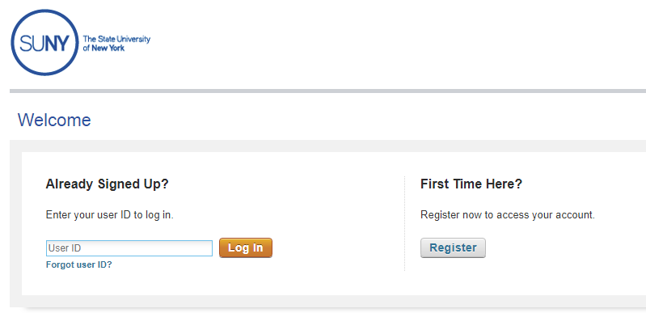
SUNY Retirement @ Work
All retirement elections are completed online at www.retirementatwork.org/suny
Retirement Elections should be made within 30 days from your hire date
ERS/ TRS Enrollments completed online then application turned into Human Resources

Slide 9
Voluntary Savings Plan Options
Can put away more money toward retirement
on a tax-deferred basis
Can choose from a variety of investment options
Can start or discontinue at any time
Roth option is available
Vendors to choose from
    TIAA
    Corebridge Financial (Formerly AIG)
    Voya
    Fidelity

Slide 10
Voluntary Savings Plans
SUNY 403(b) Plan
2023 IRS Limits
  100% of salary up to $22,500
  Employees age 50 and up can contribute an additional $7,500
  Enrollment is completed online at www.retirementatwork.org/suny
NYS Deferred Compensation Plan 457(b) Plan
  Enrollment is completed online at: https://www.nysdcp.com/rsc-web-preauth/index.html

Slide 11
Health Insurance
28-day waiting period
Individual or Family Coverage
Rx included in the health plan options
Empire Plan or HIP (HMO)

Slide 12
HMO (Health Maintenance Organization)
HIP is the HMO provider
  Primary care physician would designate hospitalization/medical care
  Need referral for other providers
  No claim forms to submit
  No deductibles
  Small copays

Slide 13

The Empire Plan
The Empire Plan is a specially-made plan
for New York State employees ...
Various insurance companies
(who are otherwise unaffiliated)
have agreed to provide coverage under the general “umbrella” of the Empire Plan

Slide 14
The Empire Plan
Under the Empire “Umbrella”
  Hospital: Empire Blue Cross and Blue Shield
  Major Medical: United Health Care
  Mental Health and Substance Abuse: Carelon Behavioral Health, Inc.
  Prescriptions: CVS/Caremark

Slide 15
The Empire Plan
Participating Provider
Basic Medical (non-participating)
No deductible
Small copays
Less out of pocket cost
No claims to submit
Meet deductible
  ($1250 combined)
80% reimbursement
  (“reasonable and customary”)
Submit claim forms

Slide 16
Empire Plan Prescription Coverage
Up to a 30-day supply from participating retail pharmacy or through mail service
  $5 generic
  $30 preferred brand name
  $60 non-preferred brand name
Up to a 90-day supply through the mail service
  $5 generic
  $55 preferred brand name
  $110 non-preferred brand name
Up to a 90-day supply from a participating retail pharmacy
  $10 generic
  $60 preferred brand name
  $120 non-preferred brand name

Slide 17
2023 Health Plan Rates
Plan | Salary $47,024 or less Individual | Salary $47,024 or less Family | Salary $47,024 or more Individual | Salary $47,024 or more Family
Empire Plan | $56.01 | $241.79 | $74.68 | $287.98
HIP (HMO) | $107.49 | $314.58 | $127.17 | $364.59

Slide 18
Health Insurance Enrollment
To enroll in the Health Insurance Plans we need:
  PS 404- Health Insurance Transaction Form
  Copy of Employees Birth Certificate or Passport
  Copy of Marriage Certificate for Spouse
  Copy of Financial Obligation for Spouse
  Copy of Birth Certificate or Passport for Spouse
  Copy of Birth Certificates for Children
  Enroll within 30 days of your first day of employment

Slide 19
Dental and Vision Insurance
CSEA
UUP
28 day waiting period
No premium cost
Must enroll with union benefit fund
(800) 323-2732
https://www.cseaebf.com/contact.php
28 day waiting period
No premium cost
Must enroll with union benefit fund
(800) 887-3863
https://uupinfo.org/benefits/btf.php

Slide 20
Flexible Spending Accounts
Health Care Spending Account: ($100 min./ $3,050 max. employee contribution)
- a way to use your pre-tax dollars on unreimbursed medical, dental and vision costs
Dependent Care Advantage Account: ($5,000 max. employee contribution / employer contribution will be based on your salary)
- a way to use your pre-tax dollars
to pay for child and elder care while
you are at work
- Dependent Care effective immediately
Adoption Advantage Account:
-lets you pay for expenses related to the adoption of an eligible child with pre-tax dollars
ENROLL ONLINE AT: www.flexspend.ny.gov or call 1-800-358-7202
Enroll within 60 days of your first day of employment.
Must re-enroll yearly, will not roll over.

Slide 21
New Employee Info Session
Jorge Osorio
HRIS Manager
Payroll / Time & Attendance

Slide 22
Pay Cycle
NYS employees are paid on a two-week lag basis: a two-week delay between the time the work is performed and when the salary for that work is received.
Pay period starts on Thursday and ends two weeks later on Wednesday.
Most full-time employees are processed on an annual salary basis, paid over a period of 12 months (normally 26 pay periods)
Notes:
Notes:
Paychecks are distributed to your departments

Slide 23
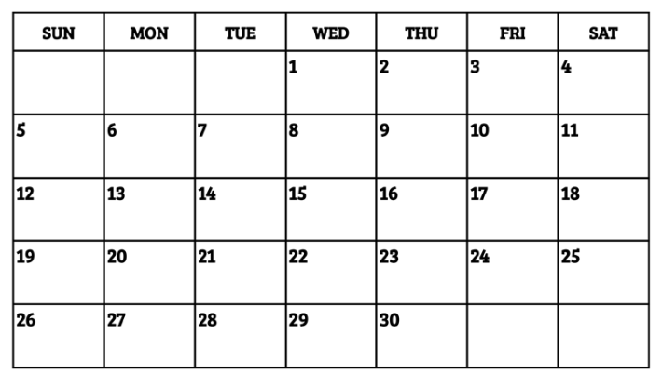



Lag Payroll
Example: If the pay period begins on the 2nd and ends on the 15th, first check would be issued on the 29th

Slide 24
The fast, convenient, and reliable way to receive your pay!
Direct deposit is available and can be split between multiple banks.
  Direct deposit advice is mailed to you to show the paycheck details (salary and deductions) as well as a listing of the account(s) to which the deposit(s) were made.
  If closing accounts, notify Payroll Office at least 3 weeks before check is due, or delays in receiving funds could occur.
Strongly recommend use of direct deposit, replacing lost/stolen check can take 6-8 weeks or more, especially if check was cashed.
Notes:
Notes
Paychecks and direct deposit statements are distributed to departments.
Strongly encourage direct deposit.
Your money is deposited & available beginning of business Wednesday paydays.
Lost checks (i.e., the employee who leaned over the manhole) can take 6-8 weeks to be replaced.
If on vacation or otherwise not at work on payday, immediate access to your money.

Slide 25
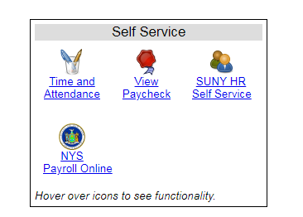
SUNY Self Service
Self Service is currently available through the SUNY portal. Features currently include:
  Time & Attendance
  View Paycheck
  Update Address
  Employees can access these functions from this website: https://www.suny.edu/hrportal

Slide 26
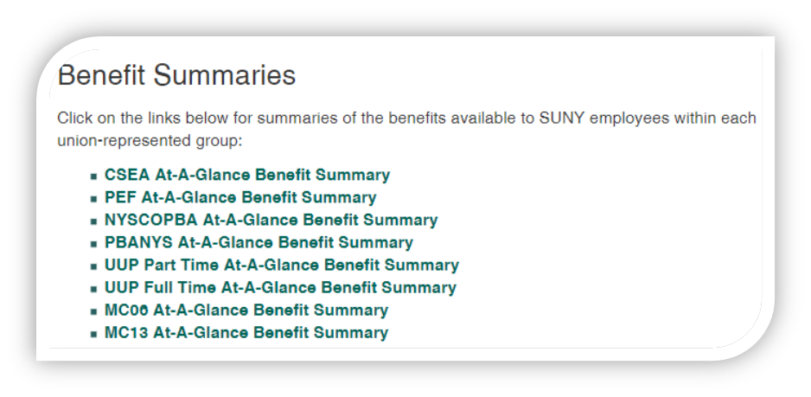
Leave Accruals
See “Benefits at a Glance” or visit the Human Resources/Benefits webpage for the accrual schedule.
Accrual balances are maintained in the Time & Attendance System
Faculty accrue sick leave only.
Professionals accrue sick and vacation leave.
Classified Service accrue sick, vacation, and personal leave.
Good news:
If you retire from state service, accrued sick leave
helps pay for your health insurance throughout
retirement!

Slide 27
Time & Attendance
All Faculty, most Professional Staff, and Administrative Classified Staff are required to submit an electronic time card through the SUNY Portal.
Professional and Faculty time cards should be submitted on a monthly basis by the 10th of each month.
Classified Administrative Staff must complete their timesheet at the end of each pay period.
10 Month Faculty are required to submit monthly time cards during their ten months of obligation (generally, August through May).

Slide 28
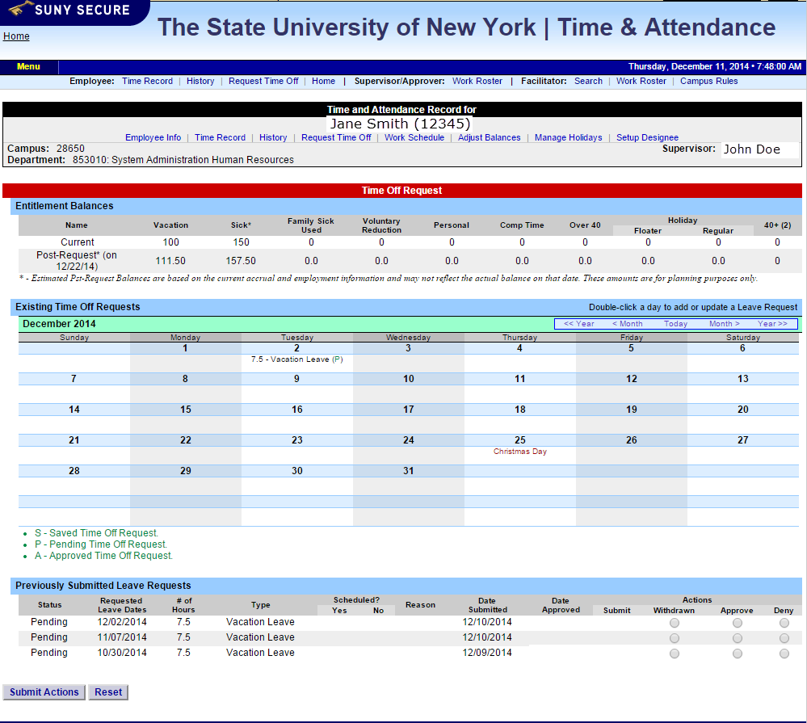
Time & Attendance
Example of monthly time record.

Slide 29
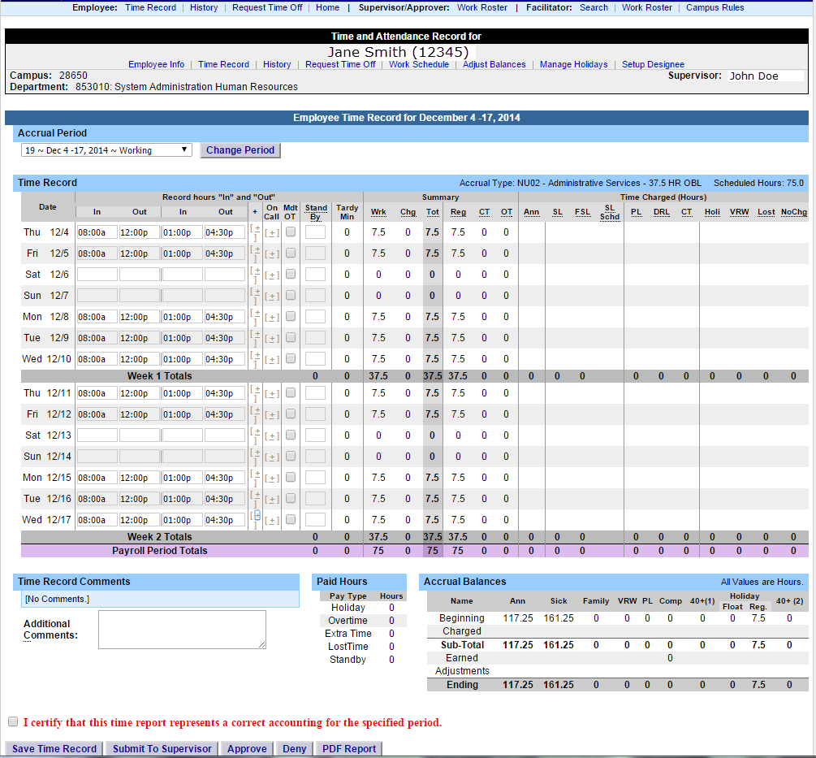
Time & Attendance
Example of hourly time record.

Slide 30

Winter Break – Non-Faculty
The campus routinely closes for Winter Break between Christmas and New Year’s Day. During this time, non-essential staff are encouraged to use vacation, holiday or compensatory leave credits.
As a new employee, you may wish to plan your time off so you have enough leave credits to take some or all of these days off.
If you don’t have the proper leave credits, you must plan with your supervisor how and what work you will perform during this period.

Slide 31

Questions?
Benefits Questions?
Email: benefits@farmingdale.edu
Human Resources Questions?
Email: hr@farmingdale.edu

