Slide 1


Time and Attendance System
Classified Staff

Slide 2

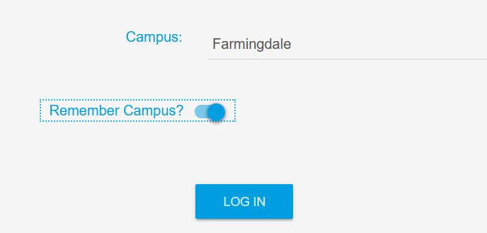
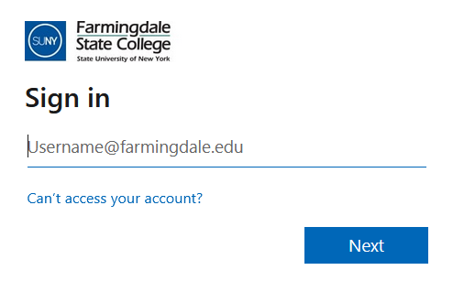


Access
To access the Time & Attendance System (TAS), please use the following link: https://www.suny.edu/time
Please save the login link as a “favorite” for easy access
Login information will be the same as your Farmingdale email credentials.

Slide 3
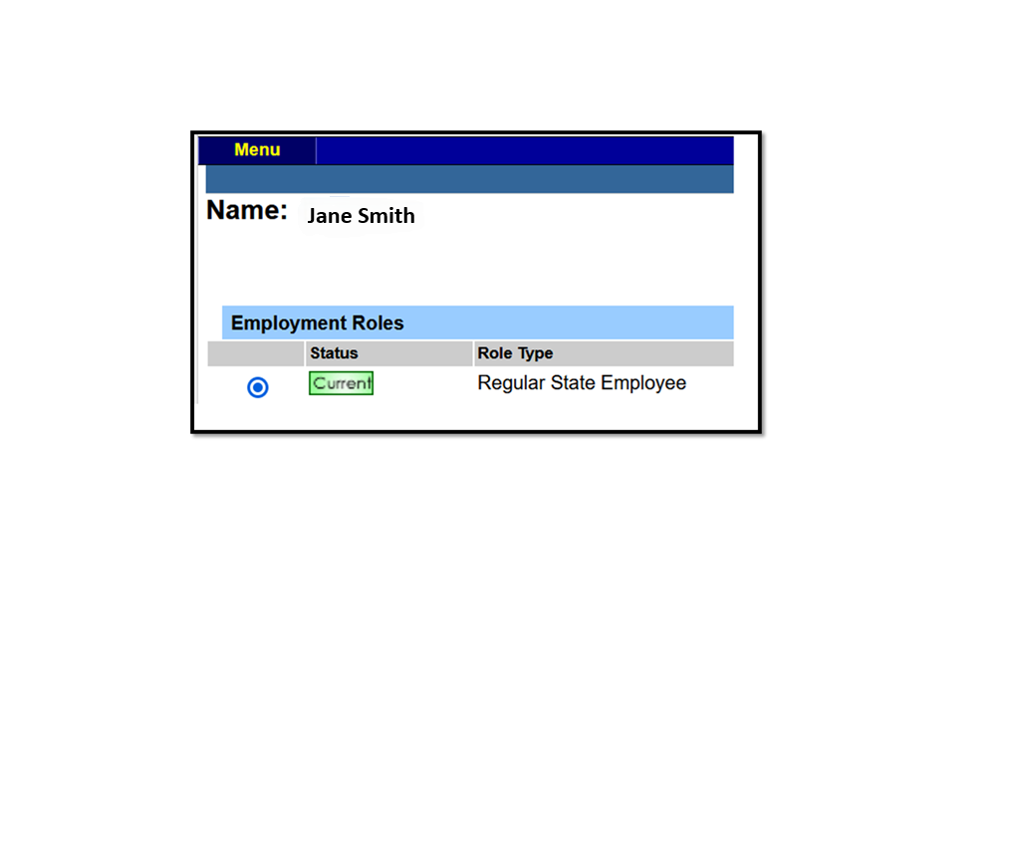

Time Record
Once logged in, select Current under Employment Roles and click on Time and Attendance to open your Time Record.

Slide 4
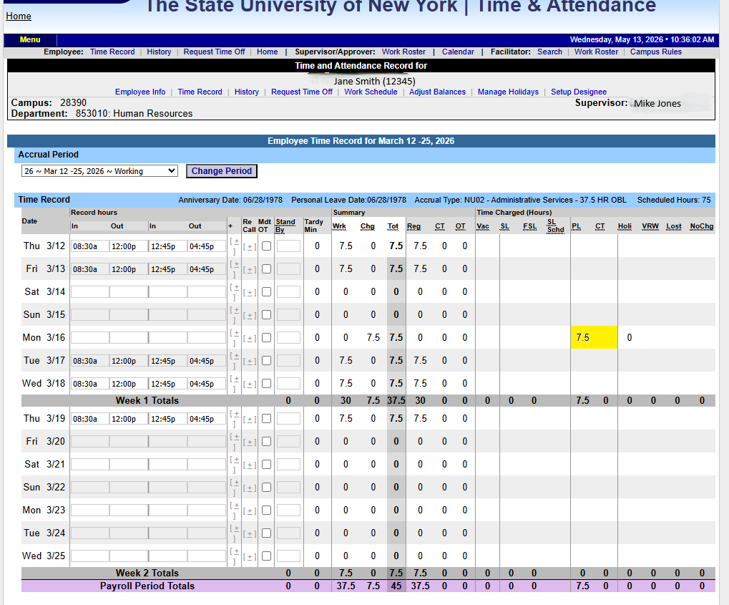
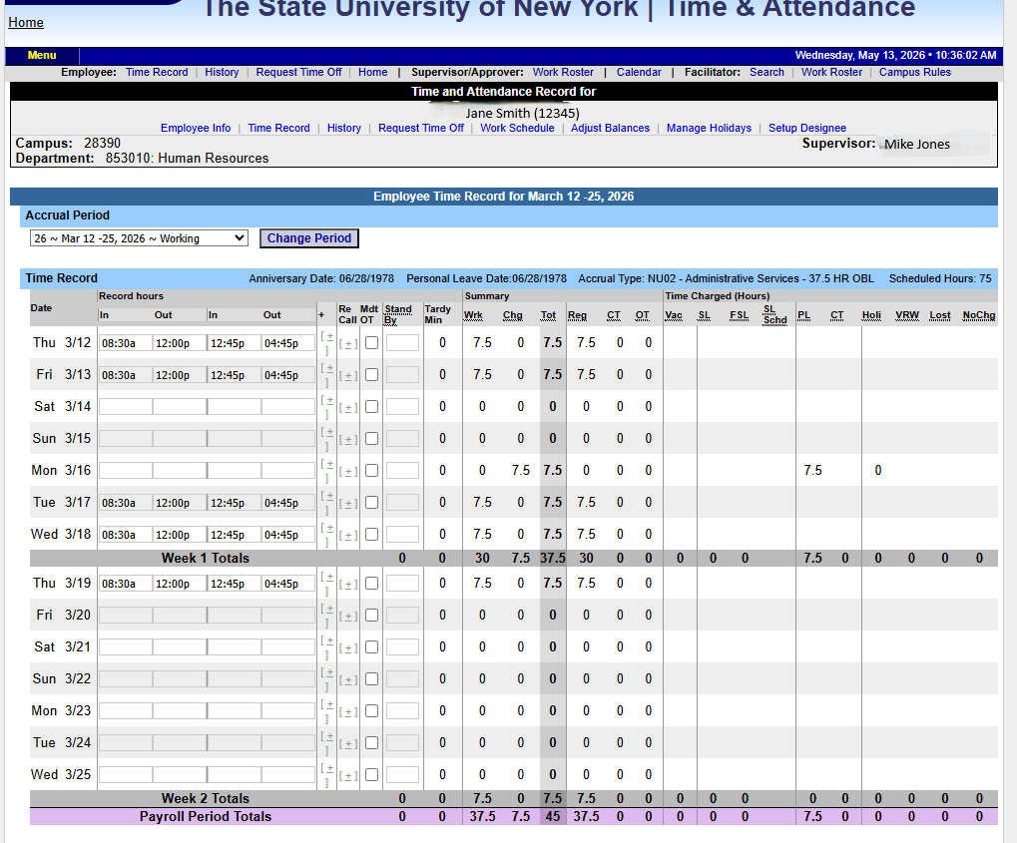
Time Record / Accrual Period
The time record defaults to the current pay period. To change it, select a period from the drop-down and click Change Period.
Enter time in and time out for each day worked. Use A for AM, P for PM, or military time. Click the first (+) button to add more in/out fields for the same day.
For overtime, check the Mdt OT box if it was mandatory. For on-call/recall, click the (+) under the On-Call column and enter time worked. For standby, enter the number of shifts under Stand By.
TAS automatically calculates summary columns (Worked, Charged, Total, Regular, Comp Time, Overtime) once time is entered.
Charged hours only appear after the supervisor approves the time-off request (highlighted in yellow). Pending requests show in red with a note at the top of the time record. To charge accruals, employees must submit a time-off request to their supervisor — see the Time-Off Request section for details.

Slide 5
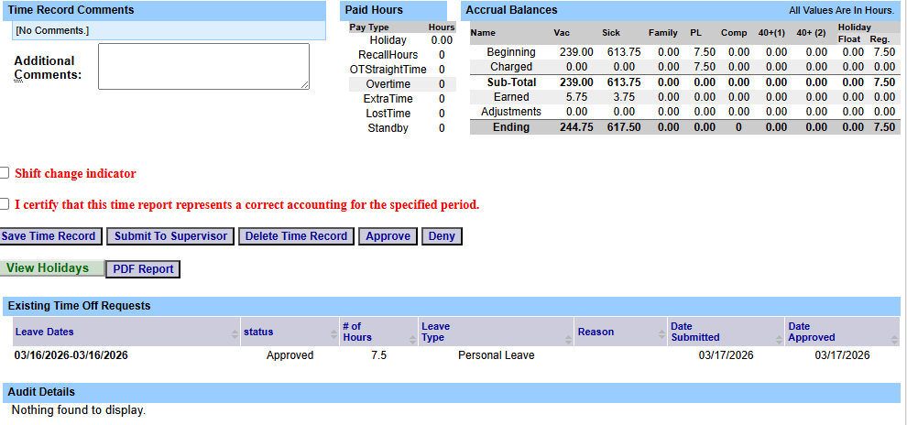
Time Record Cont’d
Enter comments in the box indicated below if you wish to submit comments to your supervisor with your time record.
Paid Hours displays the total number of hours entered within the pay period for each pay type (Holiday, RecallHours, OT StraightTime Overtime, Extra Time, Lost Time, and Standby).
Accrual Balances provides a summary of accrual balances for each accrual type, including any amounts charged within the pay period.
View Holidays displays a list of all holidays and floaters that have been earned, charged, and their expiration dates.
PDF Report allows you to generate a printable version of the time record.
Existing time‑off requests will be displayed.
Audit Details shows when the time record was submitted and when actions were taken.

Slide 6
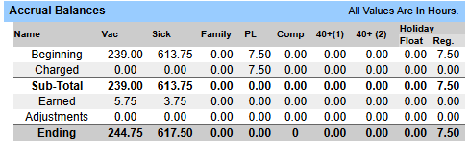
Accrual Balances
Beginning = The amount of time available to use.
Charged = The amount of time being charged.
Sub-Total = The difference between the beginning balance after charged time.
Earned = Accrual earned at the end of the pay period (Accruals cannot be used in the same pay period they are earned).
Adjustments = Updates made by HR.
Ending = Beginning balance available at the start of the next month.

Slide 7
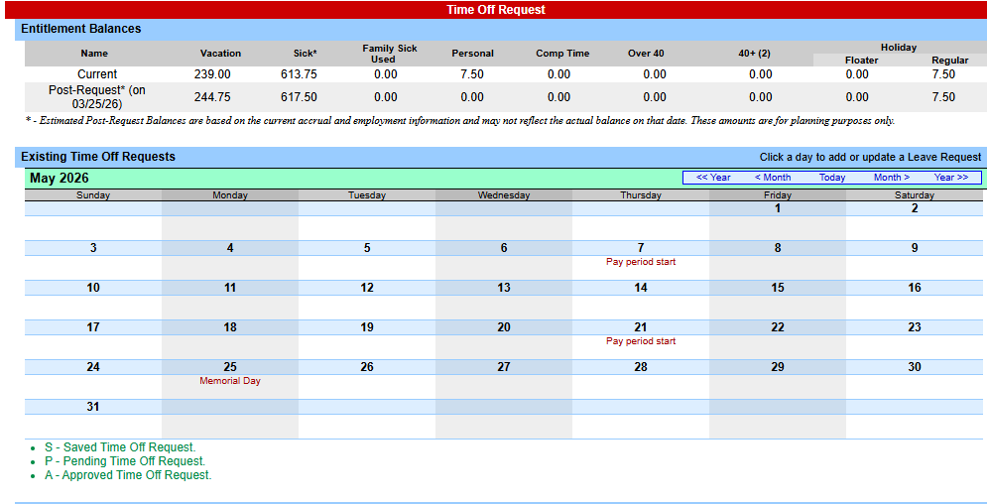
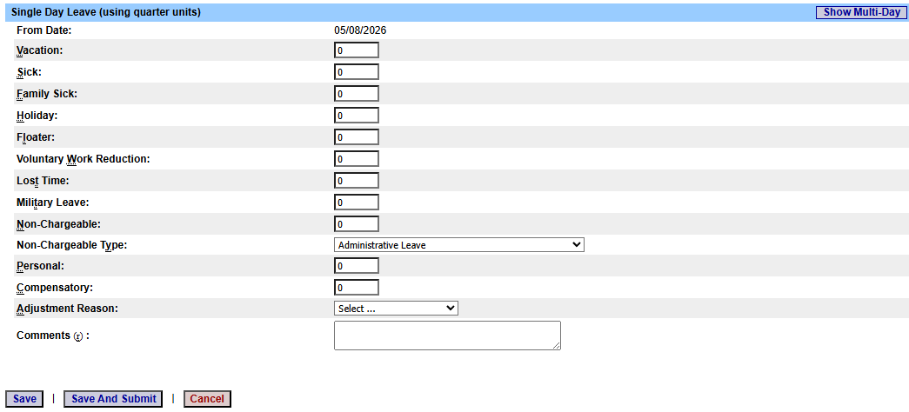
Time Off Requests
Click on the day for which you wish to enter an accrual charge.
From the pop‑up box (shown in the picture below), enter the appropriate accruals.
The pop‑up opens as a single‑day request (shown on the left).
To enter a date range, select the Show Multi Day button (shown on the right on the next screen).
Enter the increment (increments of .25 hours only) under the accrual type you wish to charge.
Select Save or Save and Submit.
Once approved, the accrual charge will appear on the time record.

Slide 8
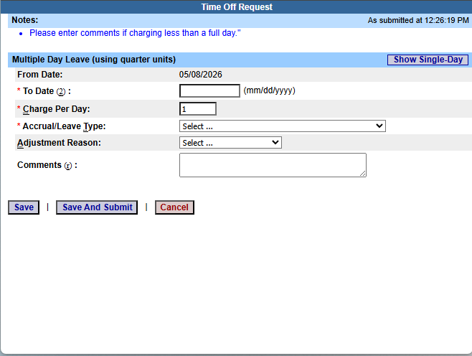
Multiple Day Time off Request
Enter the increment (increments of .25 hours only) under the accrual type you wish to charge, then select Save or Save and Submit.
Save allows employees to enter the time‑off request without submitting it to the supervisor.
Save and Submit allows employees to save and submit the time‑off request to the supervisor at the same time.
Reminders:
For a pending time‑off request, the request date will appear on the time record in red, with a note displayed at the top of the time record indicating the pending request (see screen print under Time Record).
An approved time‑off request will appear under the time charged section of the time record (see screen print under Time Record).
Accrual charges cannot span across multiple pay periods.
If a holiday falls within a time‑off charge, a separate entry must be submitted excluding the holiday.

Slide 9
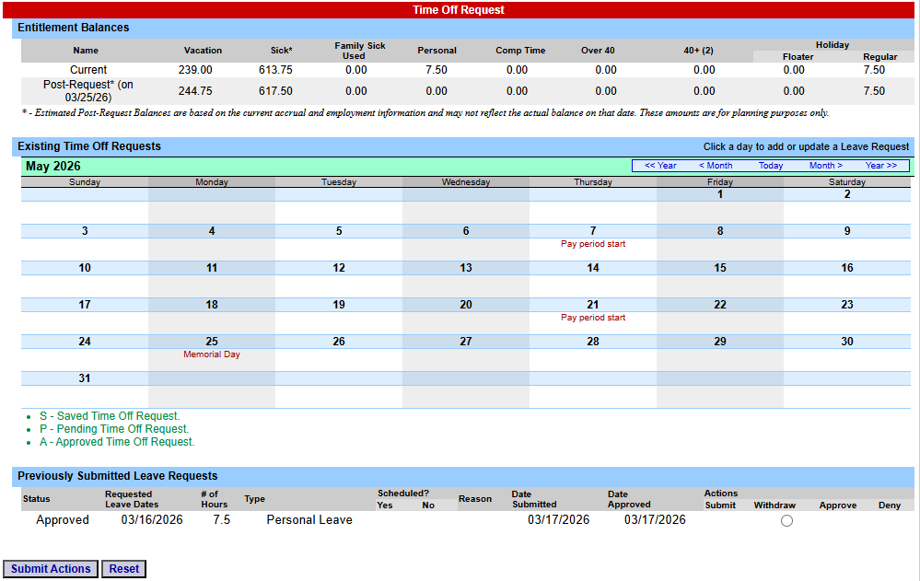
Time off Request Status
Reminders:
Once the request has been Saved or Saved and Submitted, it will appear on the calendar and under Previously Submitted Leave Requests, along with its status (Saved, Pending, or Approved).
If the request has not been submitted to the supervisor, select the radio button next to the request and click Submit Action.
Once approved, the request will appear on the corresponding time record.
The status of the request will also appear in parentheses on the monthly time record (S, P, or A).
To withdraw a previously submitted leave request that has not been approved by the supervisor, select the Withdraw radio button next to the request and click Submit Action.
Employees are able to submit a time record with a pending time‑off request.
Time‑off requests cannot span across multiple pay periods.
If a holiday falls within a time‑off request, a separate entry must be submitted excluding the holiday.

Slide 10
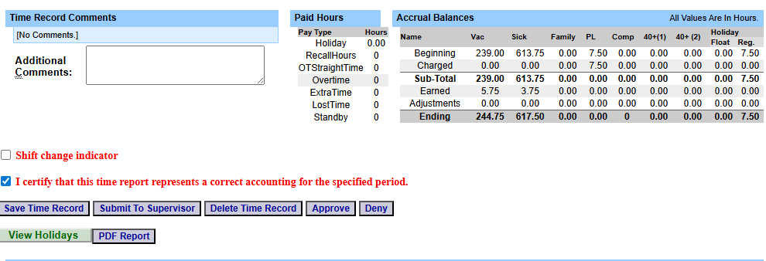
Time Record Submission
As a reminder, time records are due at the end of each Pay Period.
When you’re ready to submit, please click certify and then click Submit To Supervisor

Slide 11
Conclusion
If you run into any issues, please feel free to email HR@farmingdale.edu
Remember to submit your time record at the end of each pay period.

