Slide 1
Employee Benefits Info Session
Nichole Galvin
Benefits Manager
Human Resources

Slide 2
Employee Benefits Info Session
Retirement Plan Options
Voluntary Savings Plan Options
Health Insurance
Dental and Vision Insurance
Flex Spending Accounts

Slide 3
Retirement Plan Options
NYS ERS/TRS
Optional Retirement Program (ORP)
Teacher’s Retirement System
Employee’s Retirement System
Mandatory membership for CSEA
Full Time or Part Time Employees with a Term Appointment
Vendors to choose from
TIAA
Corebridge Financial (Formerly AIG)
Voya
Fidelity

Slide 4
Retirement Plan Options
NYS ERS/TRS
Optional Retirement Program (ORP)
Defined Benefit Plan
Final Average Salary (FAS)
Years of Employment
Age at retirement
Defined Contribution Plan
Employer Contribution
Employee Contribution
Success of Investments

Slide 5
Retirement Plan Options Vesting Periods
NYS ERS/TRS
Optional Retirement Program (ORP)
5 years of full time service
366 days, or immediately with some existing contracts

Slide 6
Retirement Plan Options Employer Contribution
NYS ERS/TRS
Optional Retirement Program (ORP)
Lump sum payments are made annually to the pension funds, not individual employee accounts
8% of salary for the first 7 years of service; 10% thereafter

Slide 7
Retirement Plan Options Death Benefit
NYS ERS/TRS
Optional Retirement Program (ORP)
Maximum: 3x salary
Minimum: ½ salary or 10,000(whichever is less)
Value of contracts on date of death
Minimum: ½ salary or 10,000(whichever is less)

Slide 8
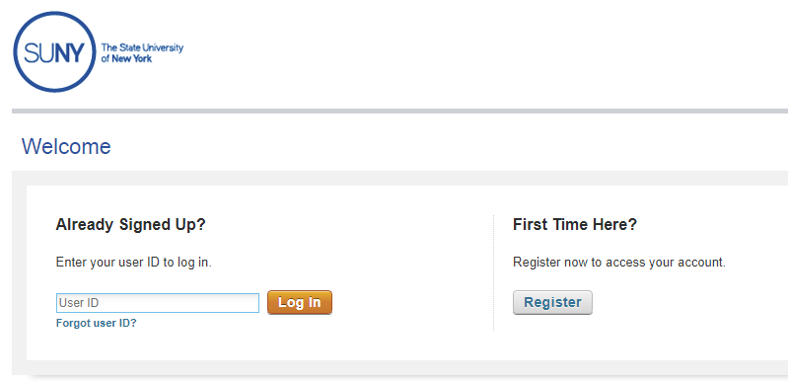
SUNY Retirement @ Work
All retirement elections are completed online at www.retirementatwork.org/suny
Retirement Elections should be made within 30 days from your hire date
ERS/ TRS Enrollments completed online then application turned into Human Resources

Slide 9
Voluntary Savings Plan Options
Can put away more money toward retirement on a tax-deferred basis
Can choose from a variety of investment options
Can start or discontinue at any time
Roth option is available
Vendors to choose from
TIAA
Corebridge Financial (Formerly AIG)
Voya
Fidelity

Slide 10
Voluntary Savings Plans
SUNY 403(b) Plan
2023 IRS Limits
100% of salary up to $22,500
Employees age 50 and up can contribute an additional $7,500
Enrollment is completed online at www.retirementatwork.org/suny
NYS Deferred Compensation Plan 457(b) Plan
Enrollment is completed online at: https://www.nysdcp.com/rsc-web-preauth/index.html

Slide 11
Health Insurance
42-day waiting period (M/C employees 56 day)
Individual or Family Coverage
Rx included in the health plan options
Empire Plan or HIP (HMO)

Slide 12
HMO (Health Maintenance Organization)
HIP is the HMO provider
Primary care physician would designate hospitalization/medical care
Need referral for other providers
No claim forms to submit
No deductibles
Small copays

Slide 13
The Empire Plan
The Empire Plan is a specially-made plan for New York State employees ...
Various insurance companies (who are otherwise unaffiliated) have agreed to provide coverage under the general “umbrella” of the Empire Plan

Slide 14
The Empire Plan
Under the Empire “Umbrella”
Hospital: Empire Blue Cross and Blue Shield
Major Medical: United Health Care
Mental Health and Substance Abuse: Beacon Health Options
Prescriptions: CVS/Caremark

Slide 15
The Empire Plan
Participating Provider
Basic Medical (non-participating)
No deductible
Small copays
Less out of pocket cost
No claims to submit
Meet deductible
($1250 combined)
80% reimbursement
(“reasonable and customary”)
Submit claim forms

Slide 16
Empire Plan Prescription Coverage
Up to a 30-day supply from participating retail pharmacy or through mail service
$5 generic
$30 preferred brand name
$60 non-preferred brand name
Up to a 90-day supply through the mail service
$5 generic
$55 preferred brand name
$110 non-preferred brand name
Up to a 90-day supply from a participating retail pharmacy
$10 generic
$60 preferred brand name
$120 non-preferred brand name

Slide 17
2023 Health Plan Rates
Plan | Salary $47,024 or less Individual | Salary $47,024 or less Family | Salary $47,024 or more Individual | Salary $47,024 or more Family
Empire Plan | $56.01 | $241.79 | $74.68 | $287.98
HIP (HMO) | $107.49 | $314.58 | $127.17 | $364.59

Slide 18
Health Insurance Enrollment
To enroll in the Health Insurance Plans we need:
PS 404- Health Insurance Transaction Form
Copy of Employees Birth Certificate or Passport
Copy of Marriage Certificate for Spouse
Copy of Financial Obligation for Spouse
Copy of Birth Certificate or Passport for Spouse
Copy of Birth Certificates for Children
Enroll within 30 days of your first day of employment

Slide 19
Dental and Vision Insurance
CSEA
UUP
28 day waiting period
No premium cost
Must enroll with union benefit fund
(800) 323-2732
https://www.cseaebf.com/contact.php
42 day waiting period
No premium cost
Must enroll with union benefit fund
(800) 887-3863
https://uupinfo.org/benefits/btf.php

Slide 20
Flexible Spending Accounts
Health Care Spending Account: ($100 min./ $3,050 max. employee contribution) - a way to use your pre-tax dollars on unreimbursed medical, dental and vision costs
Dependent Care Advantage Account: ($5,000 max. employee contribution / employer contribution will be based on your salary) - a way to use your pre-tax dollars to pay for child and elder care while you are at work
- Dependent Care effective immediately
Adoption Advantage Account:
-lets you pay for expenses related to the adoption of an eligible child with pre-tax dollars
ENROLL ONLINE AT: www.flexspend.ny.gov or call 1-800-358-7202
Enroll within 60 days of your first day of employment.
Must re-enroll yearly, will not roll over.

Slide 21
Questions?
Benefits Questions? Email: benefits@farmingdale.edu
Human Resources Questions? Email: hr@farmingdale.edu

